Slide 1
(Large) Language Model-based Dialogue System
Hongru WANG
The Chinese University of Hong Kong
Supervisor: Prof. Kam-Fai Wong
Notes:
Hello, all esteemed professors of the thesis committee, and distinguished guests, my name is Hongru WANG and my supervisor is prof kam-fai wong. today I will defense my research proposal named LLM as a linker integrating internal status and external sources for dialogue systems.

Slide 2
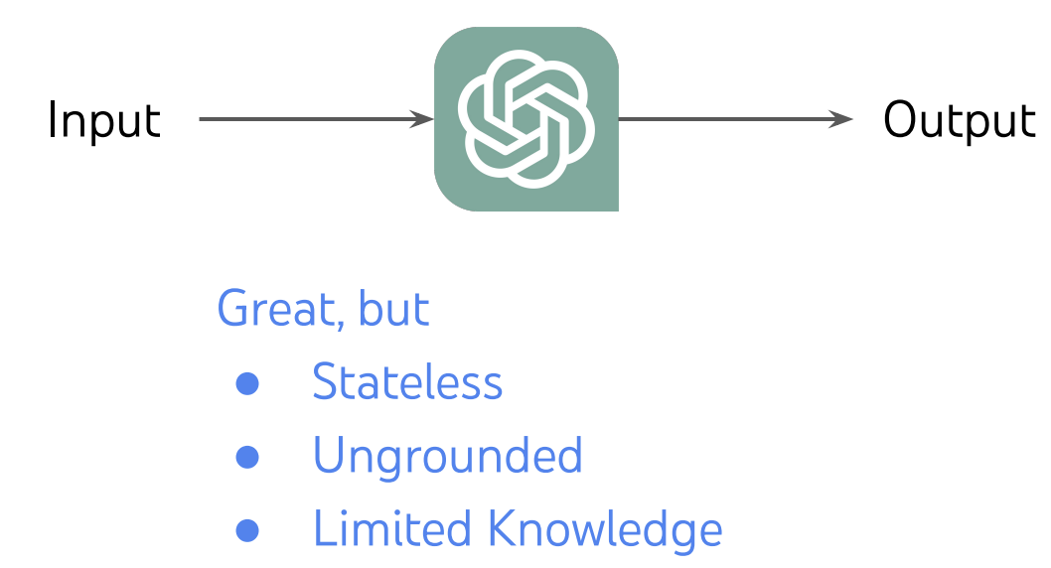
What’s Dialogue System ?
Large Language Models (ChatGPT, ChatGLM, etc.) as simplest Dialogue System

Slide 3
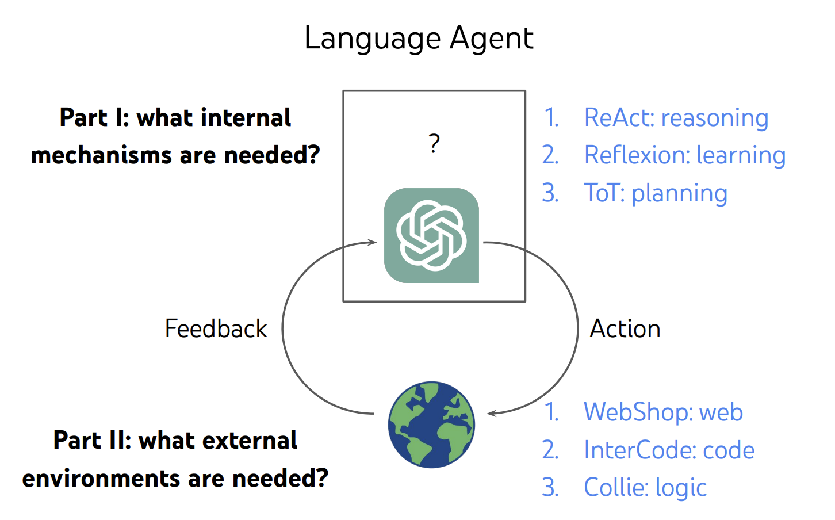
What’s Language Agent ?
LLM-based Dialogue Systems as Language Agents
https://ysymyth.github.io/papers/from_language_models_to_language_agents.pdf

Slide 4
What’s LLM-based Dialogue System ?
LLM-based
Dialogue System
Large Language Models as Source Planner for Personalized Knowledge-grounded Dialogue (External)
Cue-CoT: Chain-of-thought Prompting for Responding to In-depth Dialogue Questions with LLMs (Internal)
Evidences
Resp
Database
Emotion
Persona
Psychology
Internal Status
External
Sources
……
Document
……
Intermediate Reasoning
Memory
Dialogue
Context
TPE: Towards Better Compositional Reasoning over Conceptual Tools with Multi-persona Collaboration (Internal with External)

Slide 5
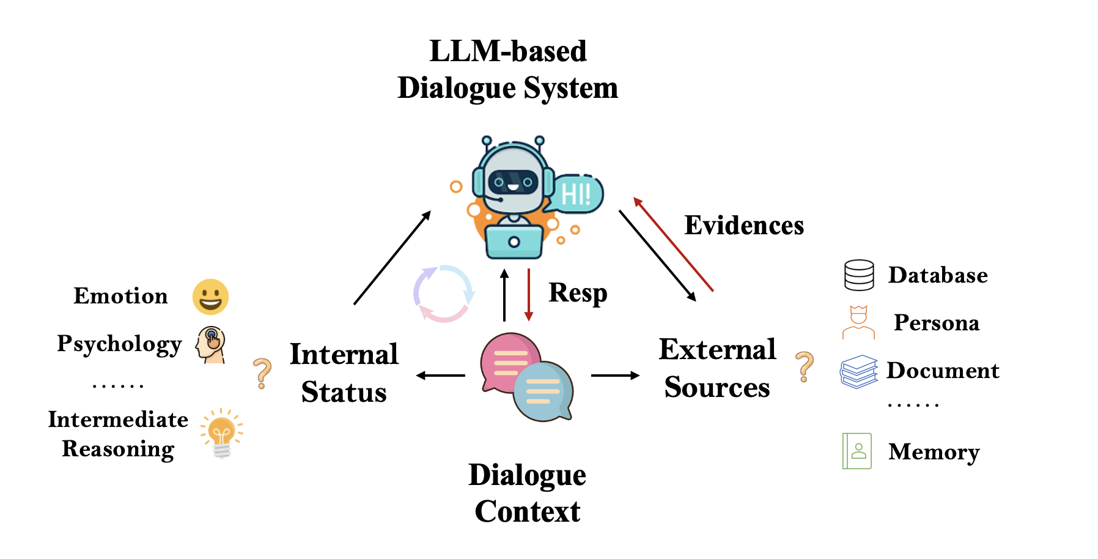
What’s LLM-based Dialogue System ?
Internal Reasoning
Prompting engineering
Linguistic cues
Emotion
Psychology
……
Intermediate reasoning
……

Slide 6
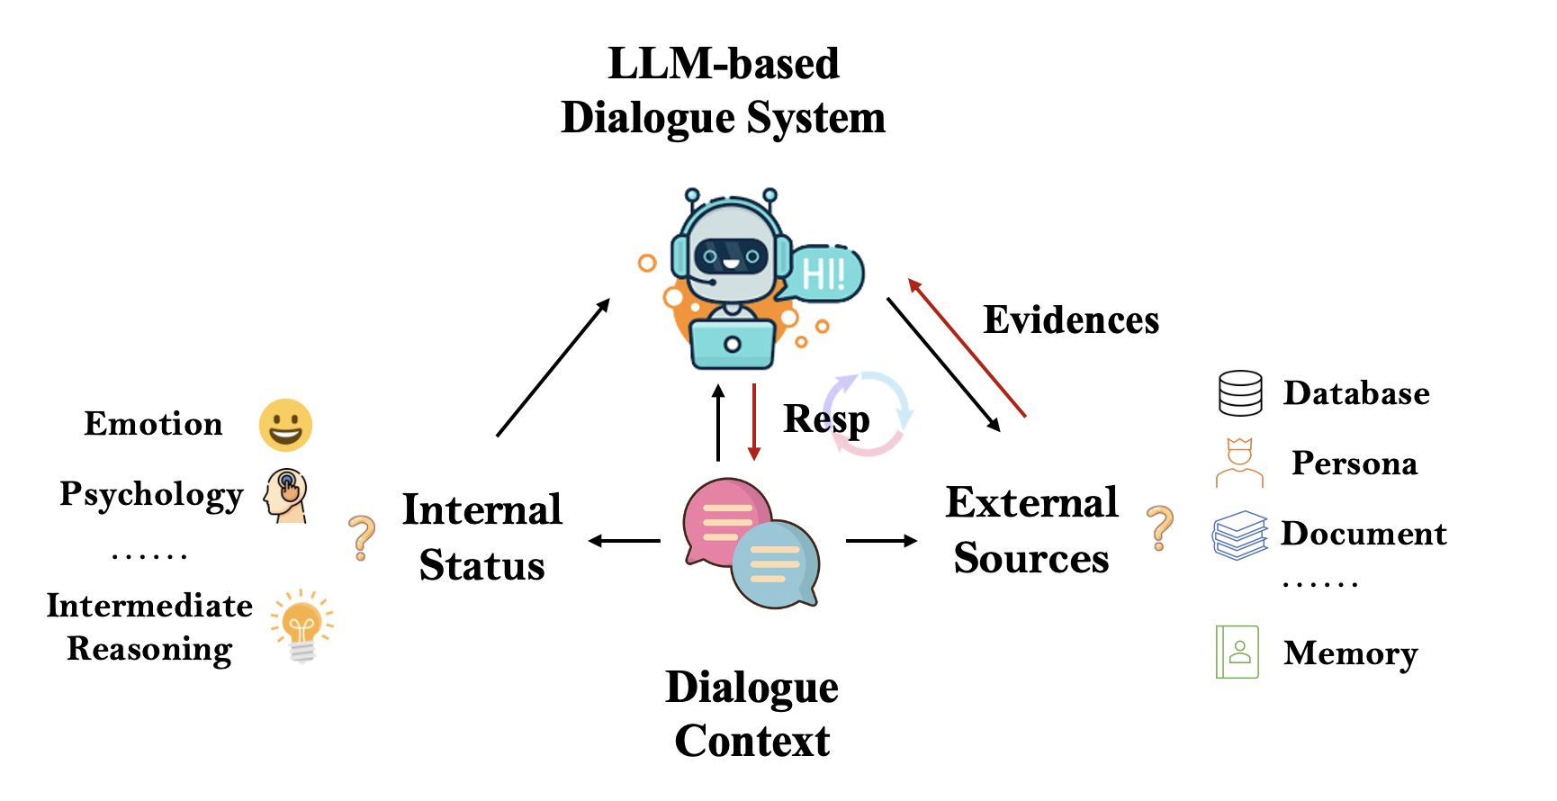
What’s LLM-based Dialogue System ?
Internal Reasoning
Prompting engineering
Linguistic cues
Emotion
Psychology
……
Intermediate reasoning
……
External Acting
Planning the actions/interactions
Generate tokens --- most fine-grained action
……

Slide 7
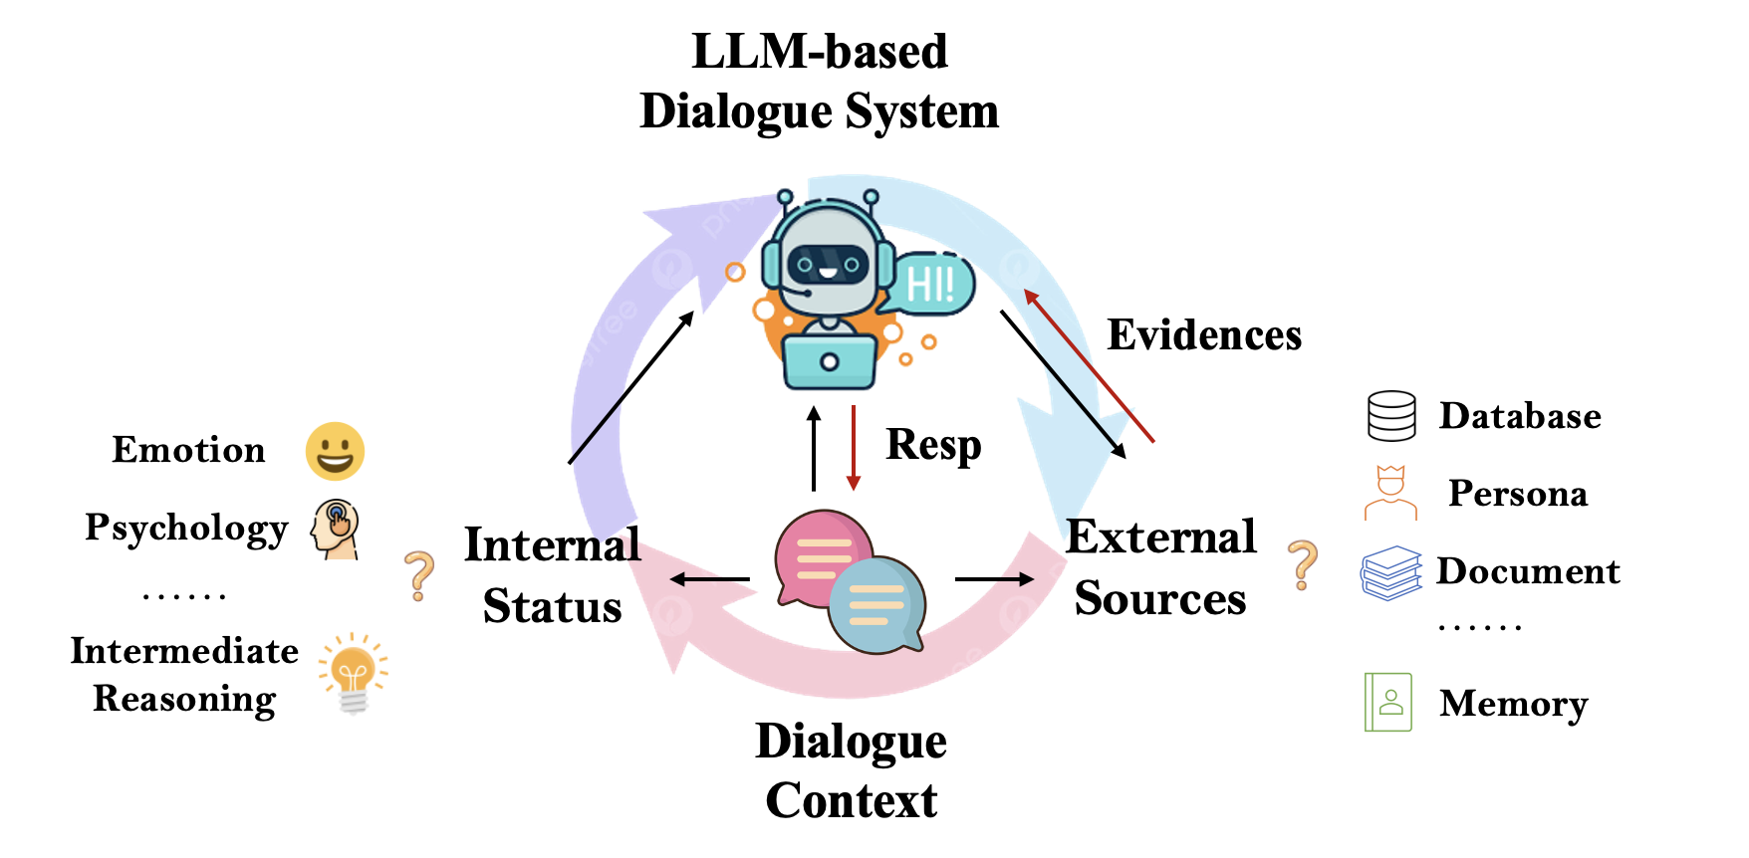
What’s LLM-based Dialogue System ?
Internal Reasoning
Prompting engineering
Linguistic cues
Emotion
Psychology
……
Intermediate reasoning
……
External Acting
Planning the actions/interactions
Generate tokens --- most fine-grained action
……
Reasoning + Acting
TPE multi-persona collaboration framework
Thinker (Reasoning)
Planner (Planning)
Executor (Acting)

Slide 8
What’s LLM-based Dialogue System ?
LLM-based
Dialogue System
Large Language Models as Source Planner for Personalized Knowledge-grounded Dialogue (External)
Cue-CoT: Chain-of-thought Prompting for Responding to In-depth Dialogue Questions with LLMs (Internal)
Evidences
Resp
Database
Emotion
Persona
Psychology
Internal Status
External
Sources
……
Document
……
Intermediate Reasoning
Memory
Dialogue
Context
TPE: Towards Better Compositional Reasoning over Conceptual Tools with Multi-persona Collaboration (Internal with External)

Slide 9
What is the internal capability ?
Large Language Models (LLMs) possesses exceptional natural language understanding and generation capabilities, making it an ideal foundation for a conversational system that provides a great user experience and significant convenience.
But:
Most of them directly mapping the dialogue context to the response
Ignoring the linguistic cues underneath dialogue context such as user status, and thus lacks the ability to employ corresponding language styles and knowledge systems when dealing with users of different personalities, emotions, and psychological states.
Notes:
Most of LLM-based DS directly mapping the dialogue context to the response
As shown in the figure, according to the content of dialogue, we can infer the persona of uses is curious, and focus on finance domain, …
To provide a tailored response, we must consider the user status exhibited during the conversation

Slide 10
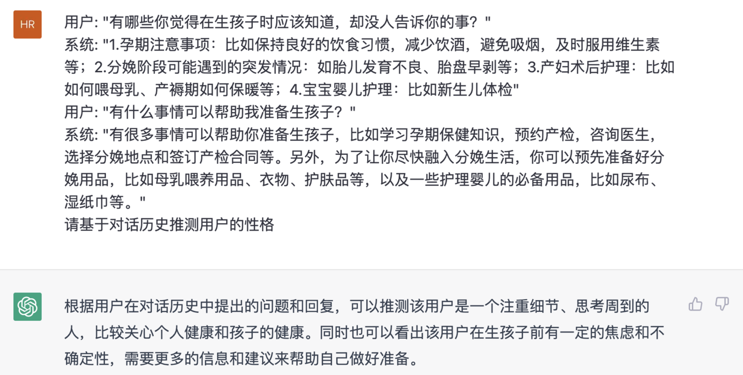
Multi-step Reasoning
We formulate it as a multi-step reasoning problem, can be alleviated by CoT, which is not explored at dialogue.
First, infer and trace the core of the user's question or concern.
Then, plan a response that takes into account their status like emotional state and psychological well-being. （optional)
…… (optional)
Finally, generate a personalized dialogue response.

Slide 11
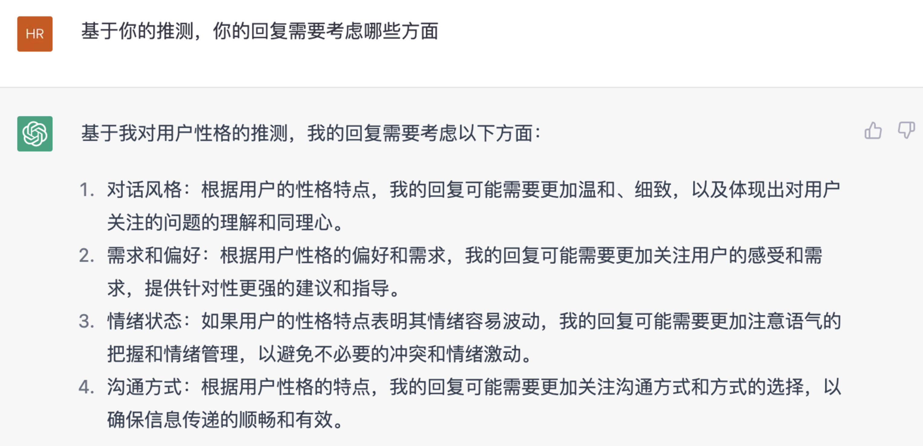
Multi-step Reasoning
We formulate it as a multi-step reasoning problem, can be alleviated by CoT, which is not explored at dialogue.
First, infer and trace the core of the user's question or concern.
Then, plan a response that takes into account their status like emotional state and psychological well-being (optional)
…… (optional)
Finally, generate a personalized dialogue response.
Notes:
Gentle, specific, and provide emotional support, and also other aspects need to attention

Slide 12
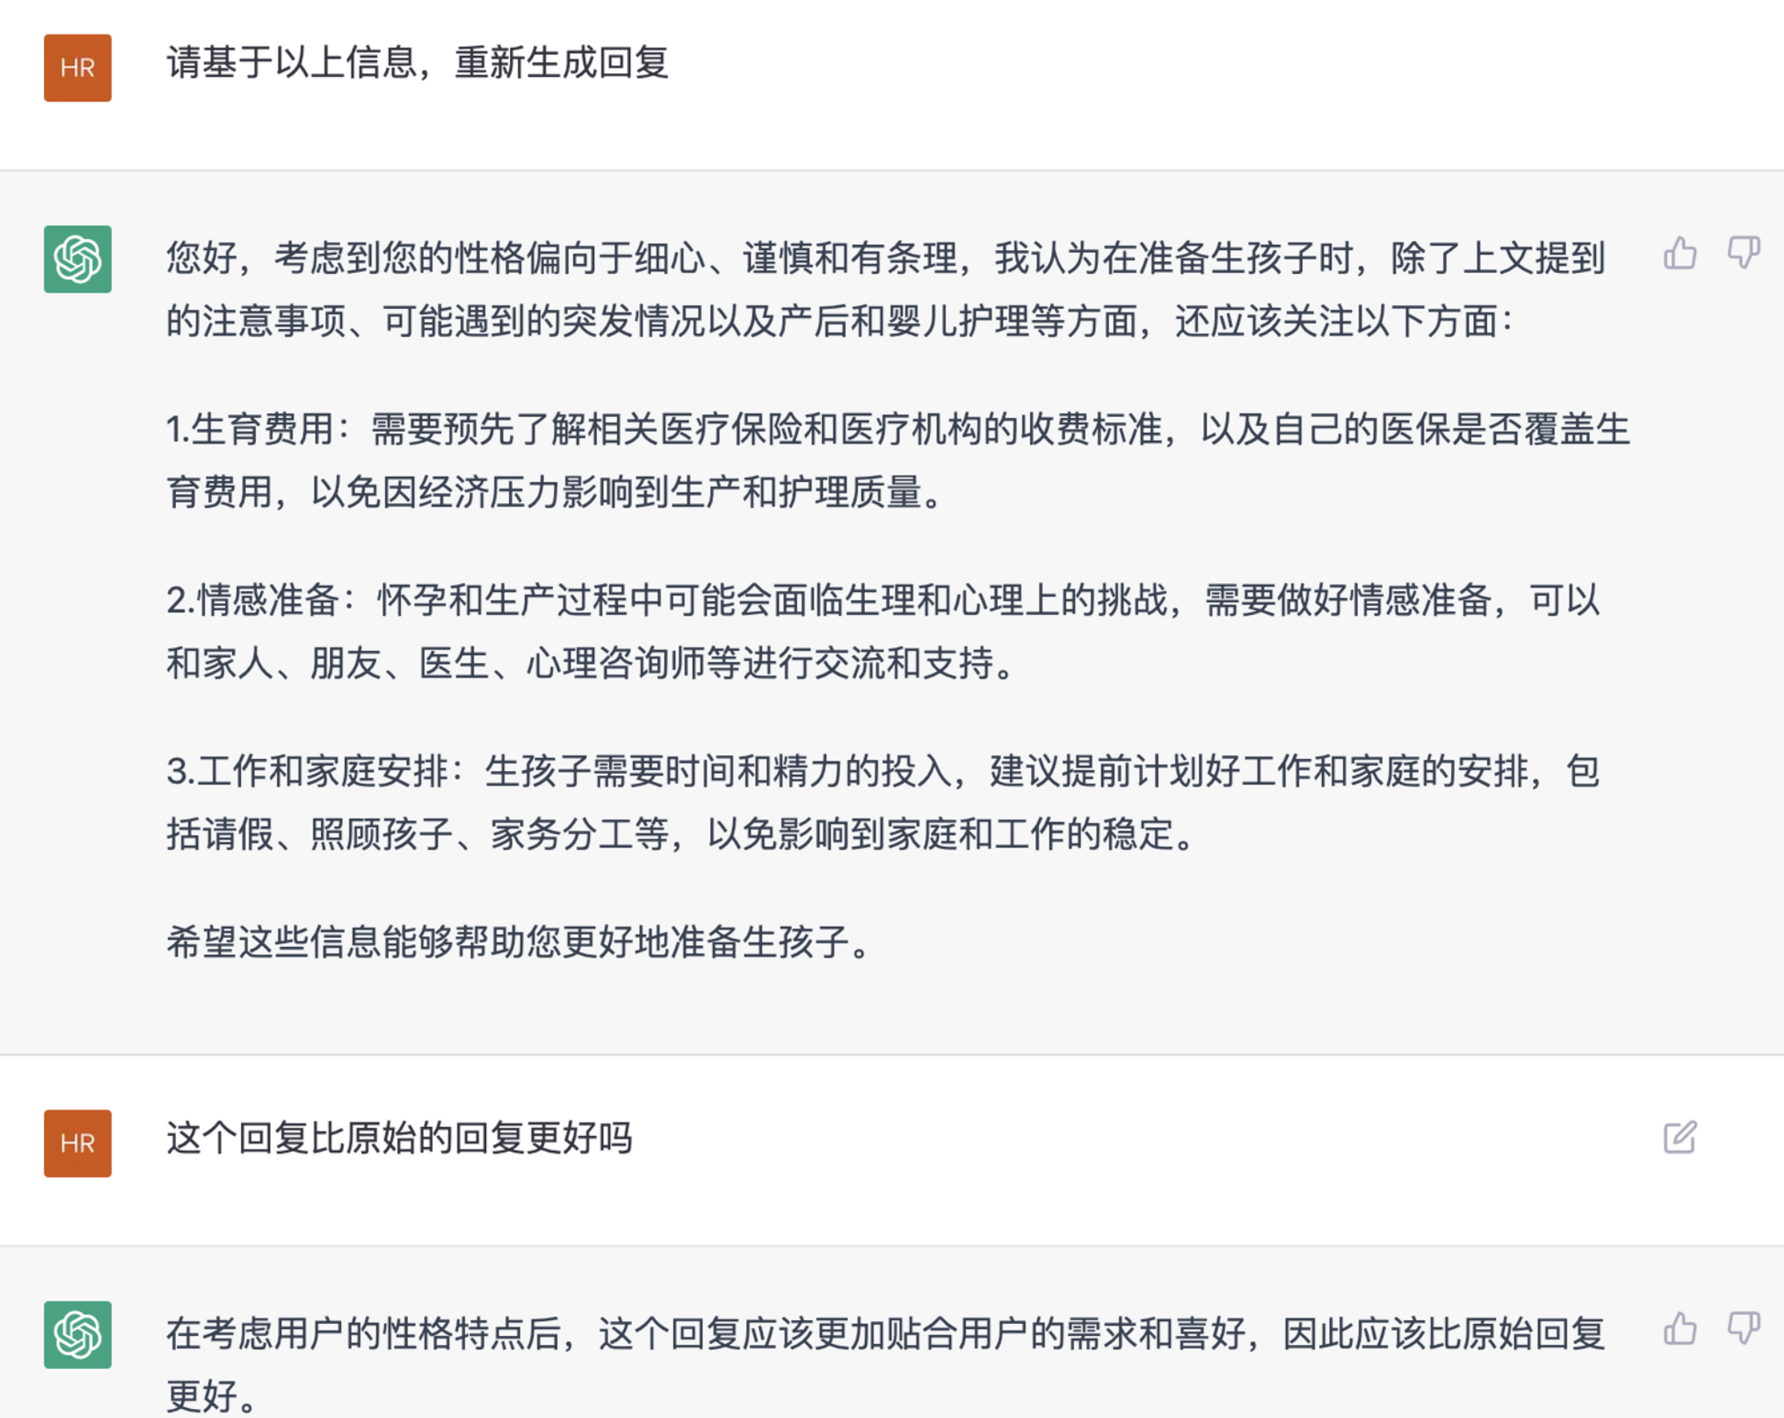
Multi-step Reasoning
We formulate it as a multi-step reasoning problem, can be alleviated by CoT, which is not explored at dialogue.
First, infer and trace the core of the user's question or concern.
Then, plan a response that takes into account their status like emotional state and psychological well-being (optional)
…… (optional)
Finally, generate a personalized dialogue response.
Notes:
Gentle, specific, and provide emotional support, and also other aspects need to attention

Slide 13
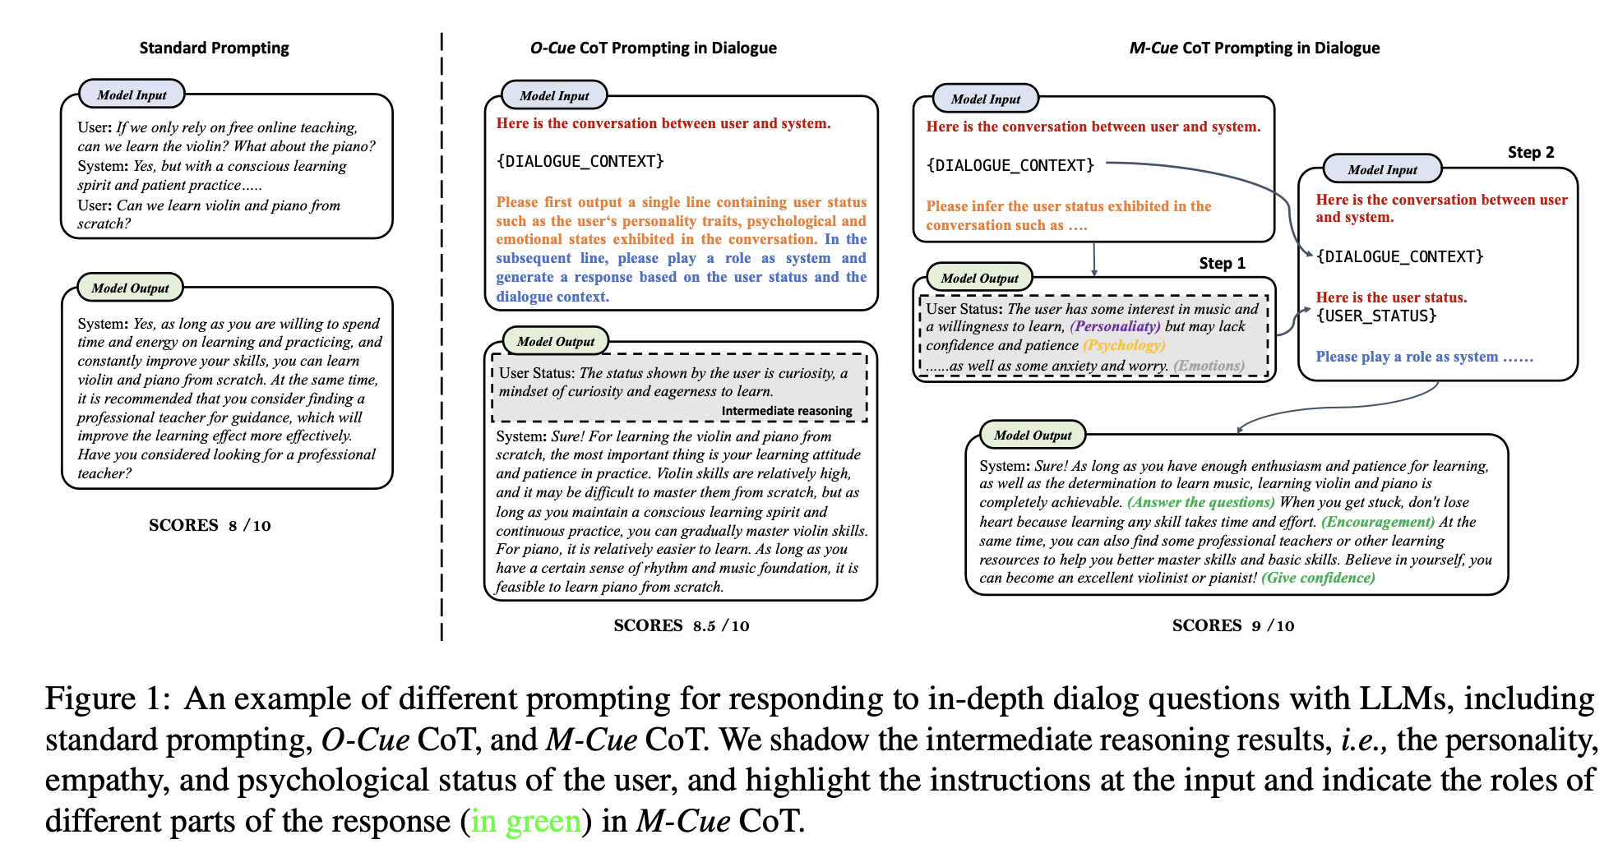
Cue-CoT
Notes:
There are many advantages of M-CoT, it is more interactive and controllable.

Slide 14
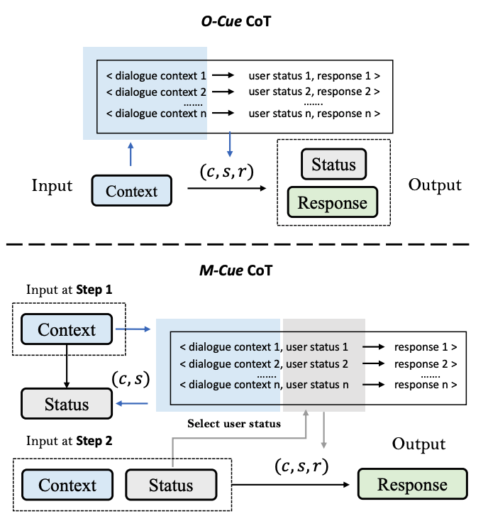
Cue-CoT (Few-shot)
Since there are multiple steps, we design different selection strategies for each step. Specifically, we first select demonstrations (c, s) according to dialogue context to infer status, and then select demonstrations (c, s, r) according to user status.
On the one hand, all intermediate reasoning results can be utilized as a criterion to select demonstrations, providing additional signals for the latter reasoning.
On the other hand, It is convenient to process these intermediate outputs, allowing for actions such as incorporating user profiles for personalization or filtering out erroneous reasoning results. These intermediate outputs can also be stored for future use, enabling their utilization for various purposes.
Notes:
There are many advantages of M-CoT, it is more interactive and controllable.

Slide 15
Benchmark
Three major linguistic cues are considered:
Personality: Zhihu & Quora (Self-built)
Emotion: D4 & ED
Psychology: PsyQA & EMH
Settings
Zero-shot
One-shot
demonstration selection
M-Cue according to internal status in 2nd step
Random
Top-1

Slide 16
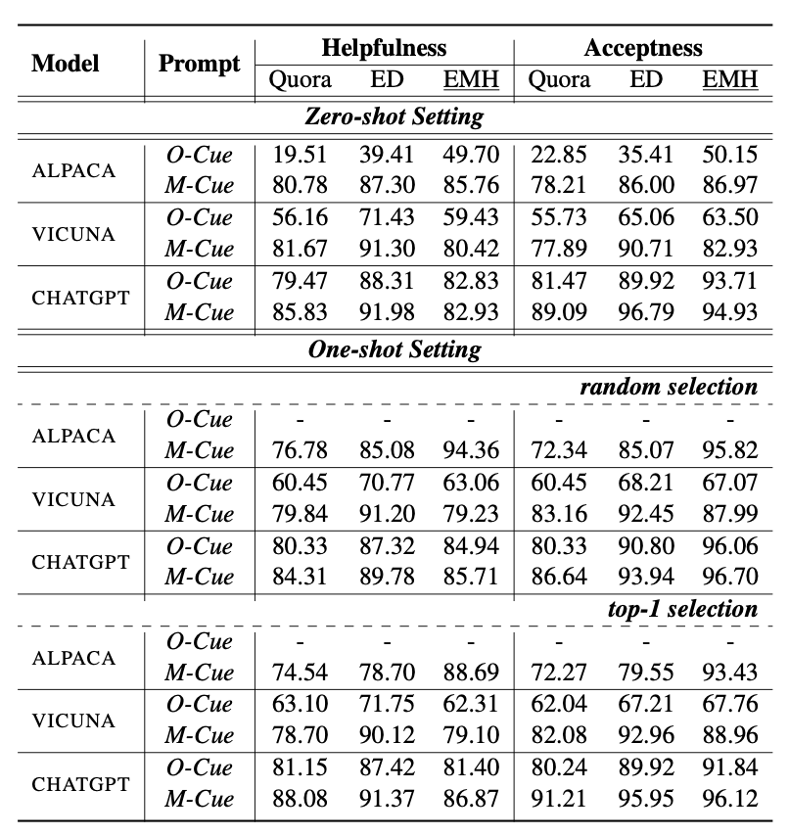
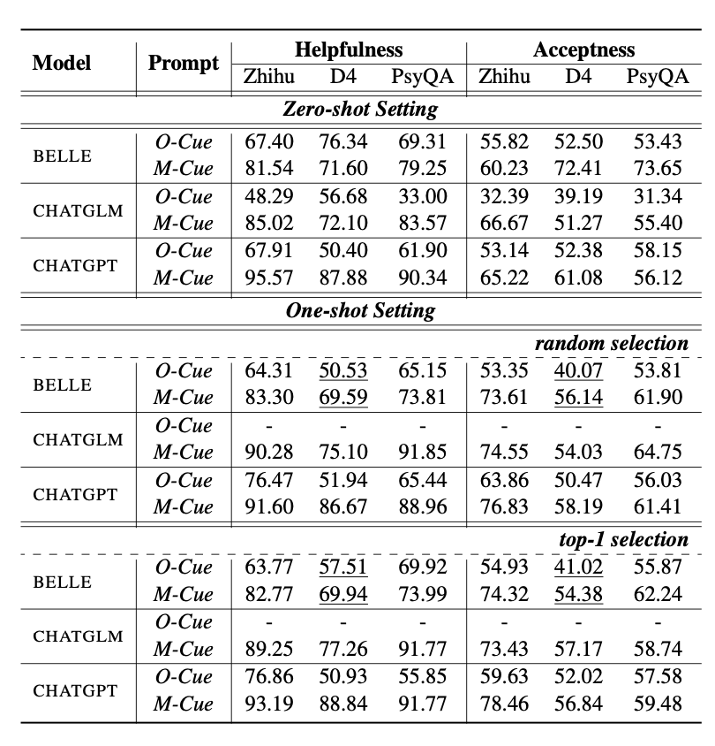
Experiment
O-Cue and M-Cue both are better than Standard Prompting, and M-Cue is more general and robust
Chinese LLMs
BELLE： low long-context understanding ability; middle instruction-following ability
ChatGLM: middle long-context understanding ability; low instruction-following ability
ChatGPT: both high
English LLMs
…….
Notes:
more fair and conviencing comparision
For Chinese llm, we can observe that chatgpt achieves better

Slide 17
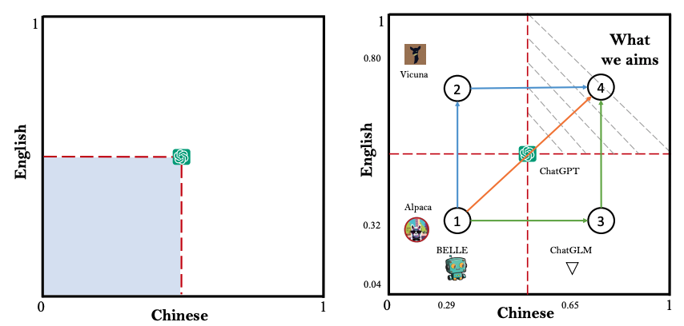
Discussion & Future Work
Path 1 (orange): Directly extend the capability of ChatGPT. GPT-4, Claude, Bard, ……
Path 2 (green): Continually train current Chinese LLMs on more multi-lingual corpus.
Path 3 (blue): Continually train current English LLMs on more multi-lingual corpus. Chinese-LLaMA, Chinese-Vicuna, …..
More analysis, case studies can be found in the paper! Demo can be accessed in the Github!!!
Notes:
more fair and conviencing comparision
For Chinese llm, we can observe that chatgpt achieves better

Slide 18
Conclusion
We build a benchmark to evaluate the helpfulness and acceptability of responses generated by current LLMs, considering three major linguistic cues of user statuses.
We leverage the strong reasoning capability of LLMs by proposing a Cue-CoT to trace the status of users, decomposing the response generation into multiple reasoning steps. It can be applied into different downstream tasks and applications with multiple intermediate results as demonstration selection criterion.
Experimental results demonstrate the superior performance of our method on 6 datasets under both zero-shot and one-shot settings. We hope the release of our work can shed some light on the evaluation and development of LLMs.
Notes:
more fair and conviencing comparision
For Chinese llm, we can observe that chatgpt achieves better

Slide 19
SAFARI (External Capability )
LLM-based
Dialogue System
Large Language Models as Source Planner for Personalized Knowledge-grounded Dialogue (External)
Cue-CoT: Chain-of-thought Prompting for Responding to In-depth Dialogue Questions with LLMs (Internal)
Evidences
Resp
Database
Emotion
Persona
Psychology
Internal Status
External
Sources
……
Document
……
Intermediate Reasoning
Memory
Dialogue
Context
TPE: Towards Better Compositional Reasoning over Conceptual Tools with Multi-persona Collaboration (Internal with External)

Slide 20
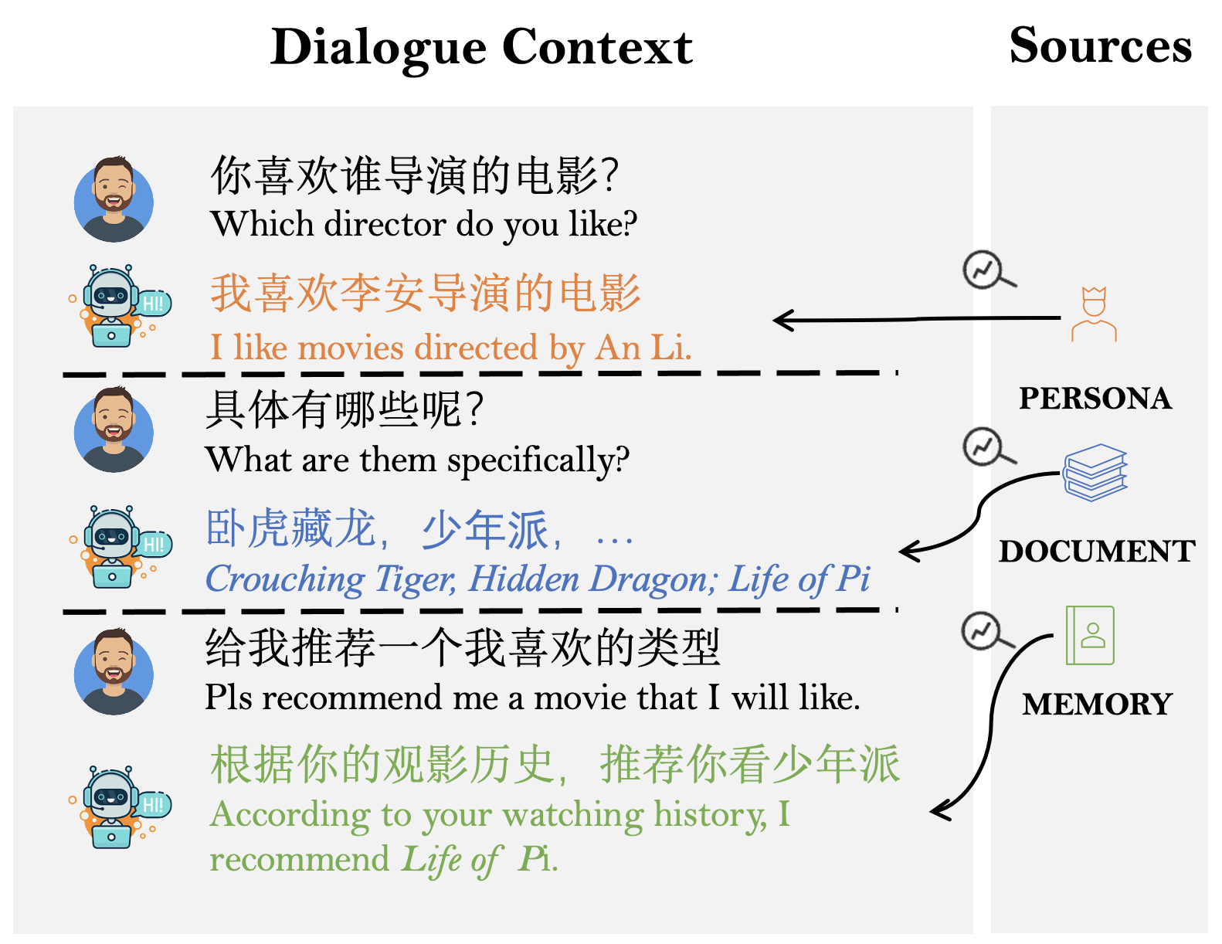
What is the external capability ?
Open-domain Dialogue System requires access to various external knowledge sources to deliver reliable, informative, personalized, and helpful responses, depending on which sources are invoked.
Indiscriminately incorporating all sources bring unnecessary computing cost, and sometimes it does not require external knowledge.
The interdependence between different external sources brings new challenges, while ignoring the complex relationship between different sources, leads to sub-optimal performance.

Slide 21
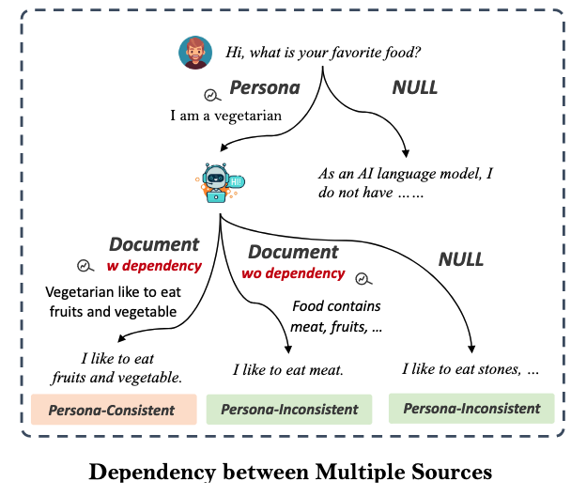
A case of dependency between different knowledge sources
How to infuse these different knowledge {Document, Persona, Memory} with dependency into one framework ?

Slide 22
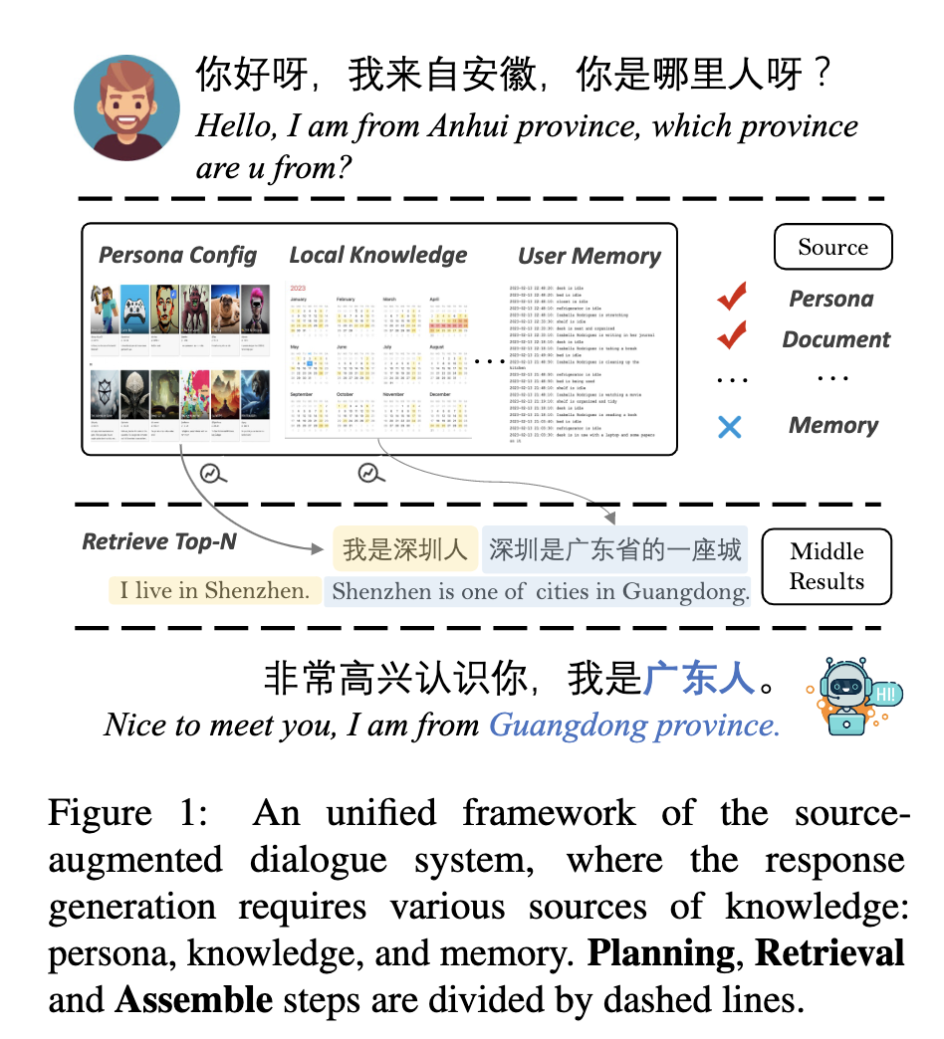
SAFARI Framework
Planning: make a series of decision to determine whether or not use knowledge, which and when.
Retrieval: retrieve top-n results from local databases according to the decided used source knowledge
Assembling: incorporate all retrieved middle results into the final response generation

Slide 23
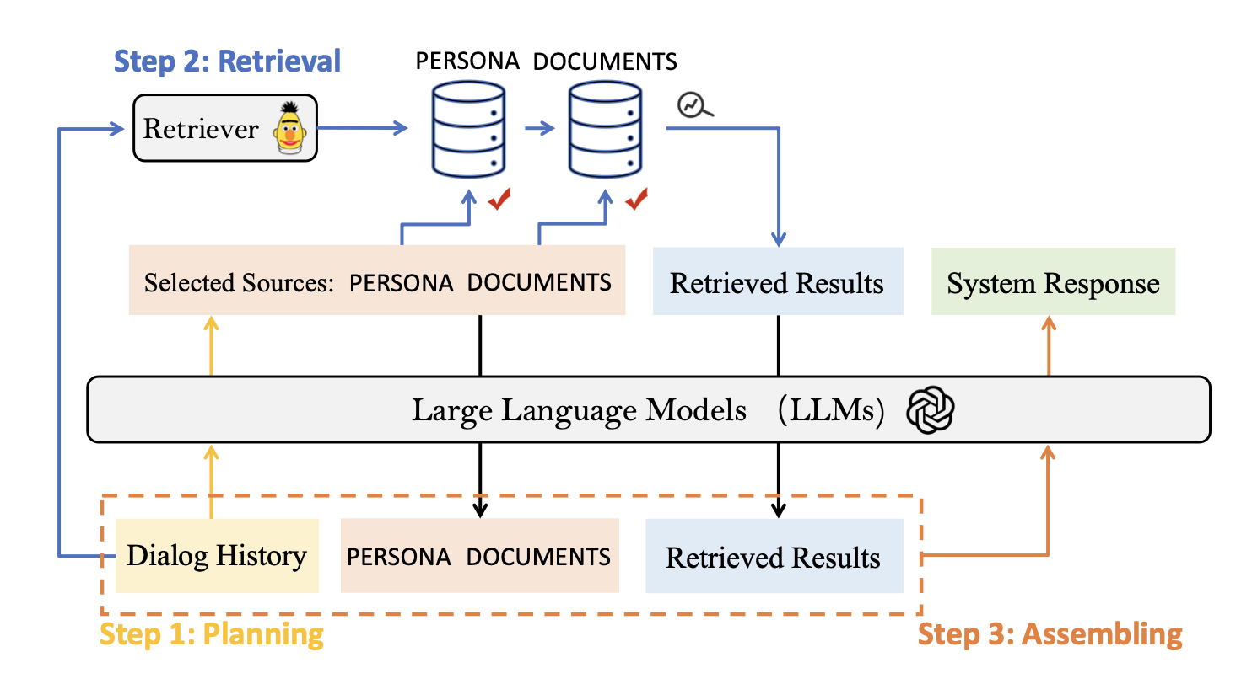
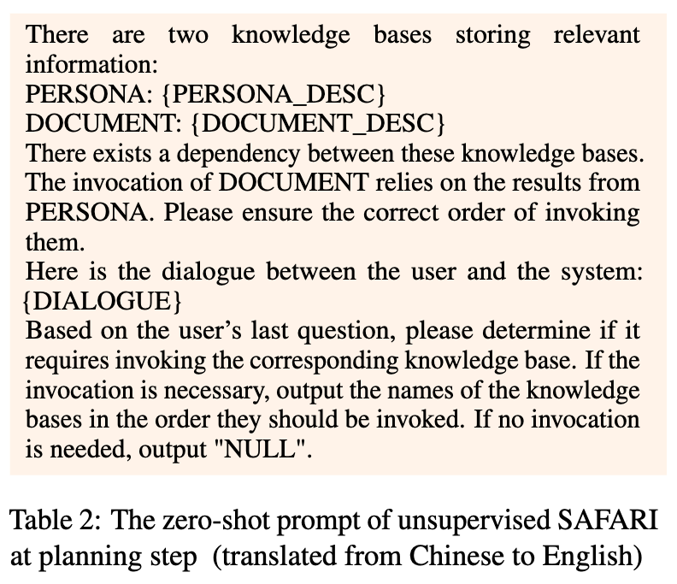
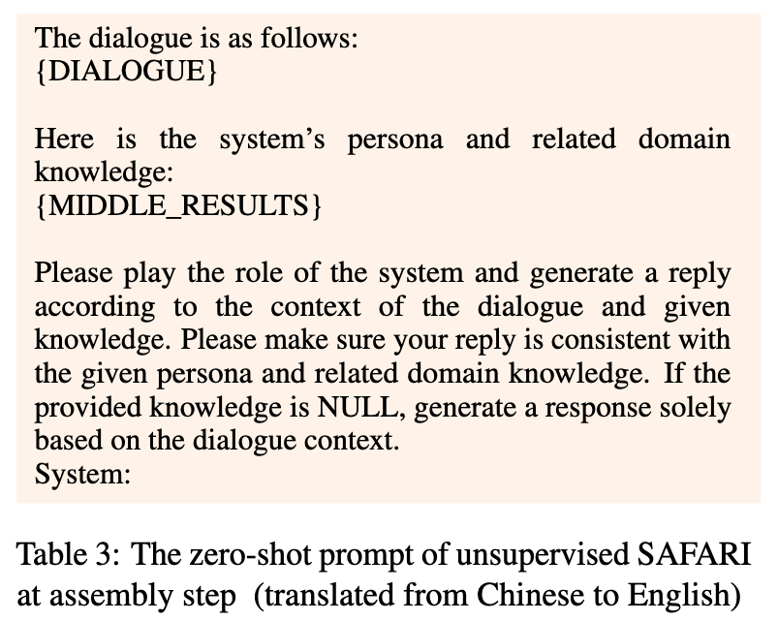
SAFARI Framework
Supervised SAFARI (End-to-end Training, LoRA)
Unsupervised SAFARI
Supervised SAFARI
Unsupervised SAFARI

Slide 24
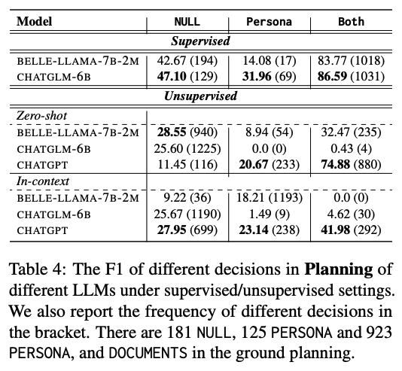
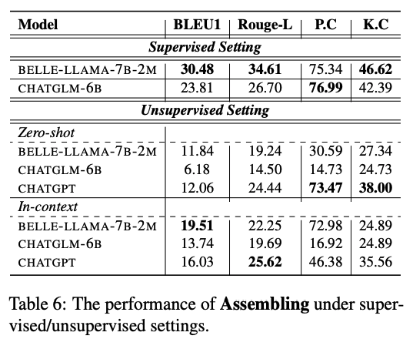
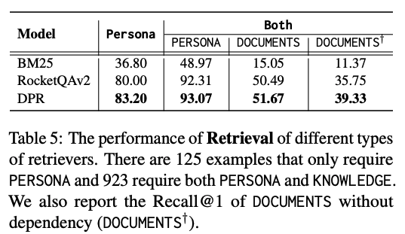
SAFARI Framework
Performance of Planning
Supervised ChatGLM > Supervised BELLE > Unsupervised ChatGPT > Others
Performance of Retrieval
DPR > RocketQAv2 > BM25
Performance of Assembling
Supervised BELLE > Supervised ChatGLM

Slide 25
Conclusions
We are the first to augment the dialogue system to plan and incorporate multiple sources of knowledge into responses (e.g., decide whether or not require knowledge, which source to call, and when to call).
We build a personalized knowledge-grounded dialogue dataset, KBP , where the responses are conditioned on multiple sources of knowledge with dependency relationship.
We conduct lots of experiments and analysis on latest LLMs. More ablation studies can be found in the paper.

Slide 26
TPE (Internal with External Capability)
LLM-based
Dialogue System
Large Language Models as Source Planner for Personalized Knowledge-grounded Dialogue (External)
Cue-CoT: Chain-of-thought Prompting for Responding to In-depth Dialogue Questions with LLMs (Internal)
Evidences
Resp
Database
Emotion
Persona
Psychology
Internal Status
External
Sources
……
Document
……
Intermediate Reasoning
Memory
Dialogue
Context
TPE: Towards Better Compositional Reasoning over Conceptual Tools with Multi-persona Collaboration (Internal with External)

Slide 27
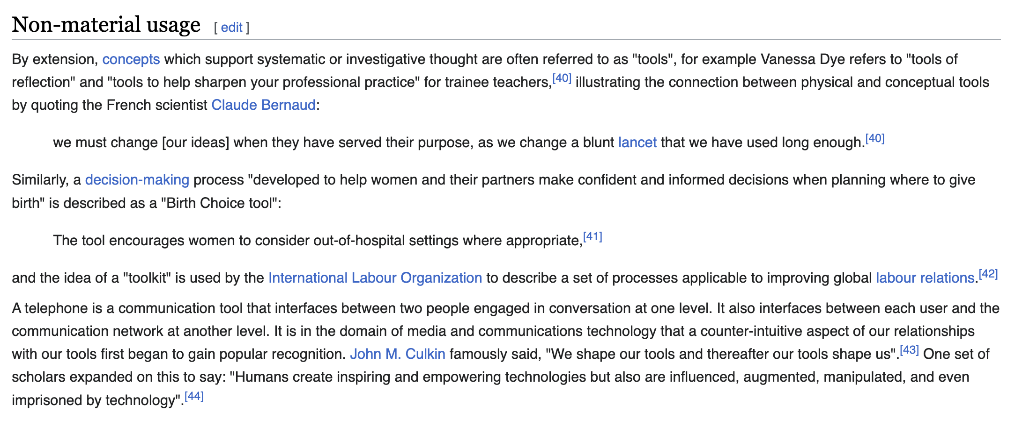
What’s tool?
Tool: An object carried or maintained for future use.
— Finn, Tregenza, and Norman, 2009.
Tool can be either:
Functional tool, or
Retriever / calculator ….
Conceptual tool
Decision-making process
Different conversational strategies
Different sources
…..
A conceptual tool specifies a cognitive concept used to help systematic or investigative thought

Slide 28
What’s tool?
Using different tools to interact with complex external environments
What is the tool ?
Functional Tool
Models
Image-to-caption
Object-detection
….
Retriever
Calculator
Programs
……
Conceptual Tool
Conversational Strategies
Question
Trust
…..
Different Sources of Knowledge
Memory
Document
….
……

Slide 29
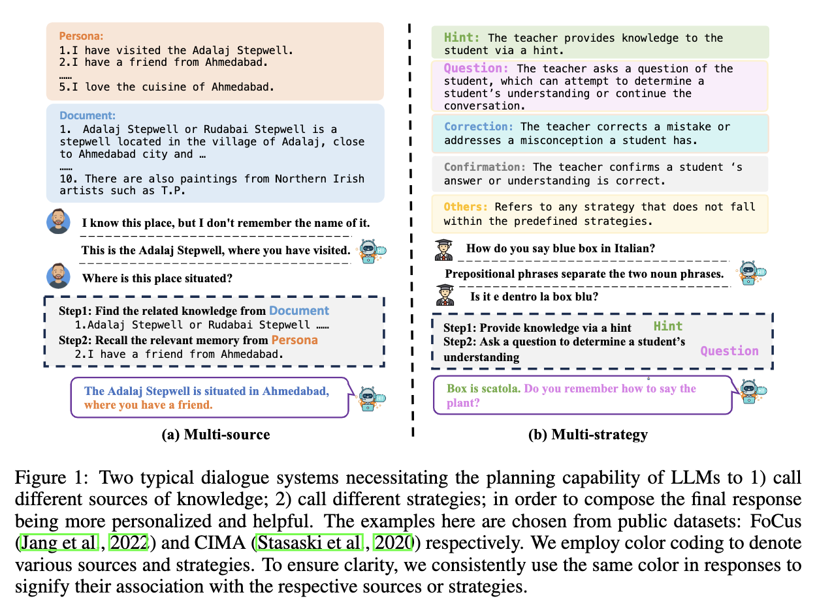
Tools in LLM-based DS
Two typical conceptual tools in DS:
Source
Memory
Documents
Persona
…
Strategy
Trust
Decompose
…

Slide 30
TPE -- Multi-persona Collaboration Framework

Slide 31
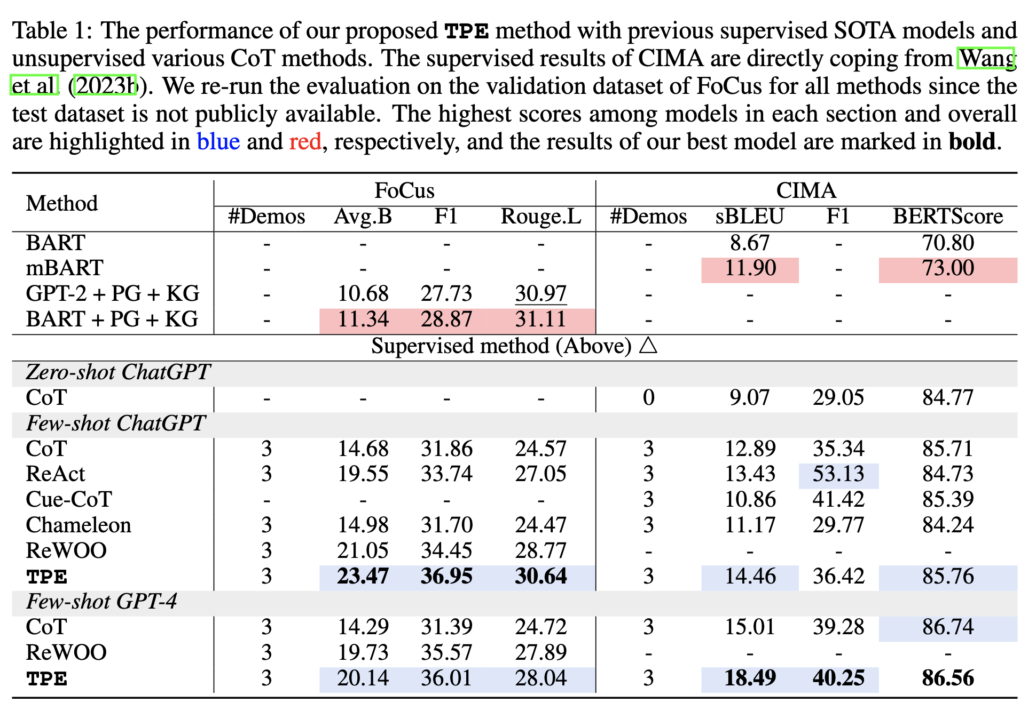
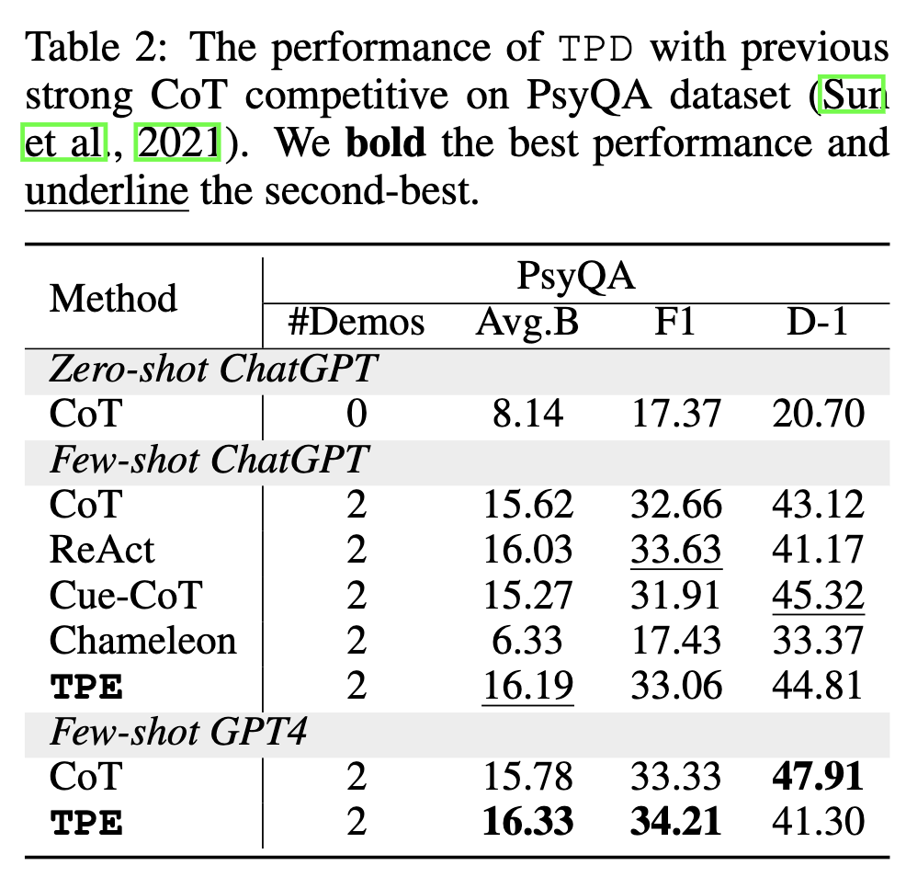
Experiment

Slide 32
Conclusion
Language Agent = reasoning + acting + memory + decision making…
Reasoning -> Prompting (CoT, ToT, CueCoT)
Acting -> Generate Tokens (Reflection tokens, SAFARI)
Memory -> One of conceptual tools
Decision making -> Contextual tools & Functional tools (TPE)
……

Slide 33
Reference
A Survey of the Evolution of Language Model-Based Dialogue Systems (all my thoughts about dialogue system)
TPE: Towards Better Compositional Reasoning over Conceptual Tools with Multi-persona Collaboration
Cue-CoT: Chain-of-thought Prompting for Responding to In-depth Dialogue Questions with LLMs EMNLP 2023
Large Language Models as Source Planner for Personalized Knowledge-grounded Dialogues EMNLP 2023

Slide 34
Q & A
Hongru WANG
https://rulegreen.github.io/
Survey Repo
Homepage
PaperWeekly Report

