Slide 1
(Large) Language Model-based Dialogue System
Hongru WANG
The Chinese University of Hong Kong
Supervisor: Prof. Kam-Fai Wong
Notes:
Hello, all esteemed professors of the thesis committee, and distinguished guests, my name is Hongru WANG and my supervisor is prof kam-fai wong. today I will defense my research proposal named LLM as a linker integrating internal status and external sources for dialogue systems.

Slide 2
What’s Dialogue System ?
Task-oriented Dialogue System (assistant)
Siri
Google Assistant
Xiao Mi (天猫小秘)
……
Open-domain Dialogue System (chatbot)
Xiaoice (Miscrosoft)
……
Task-oriented
Knowledge-grounded
Question-answering
Chit-chat
Knowledge-grounded
Question-answering

Slide 3
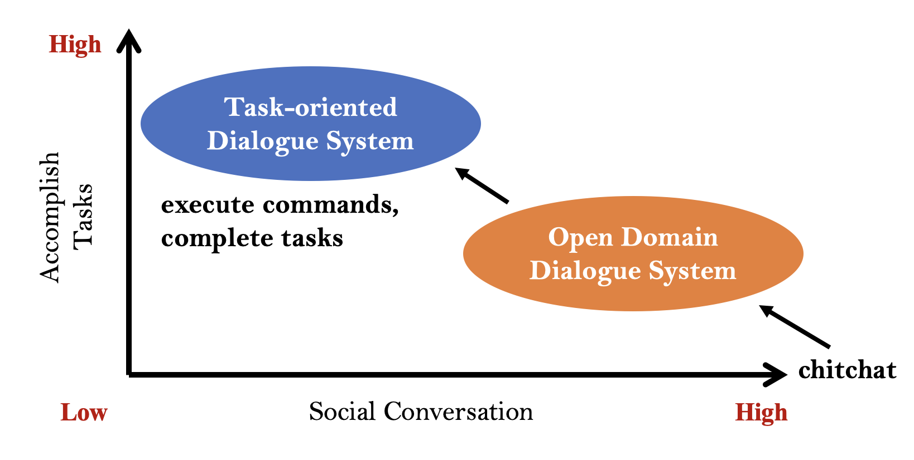
What’s Dialogue System ?

Slide 4
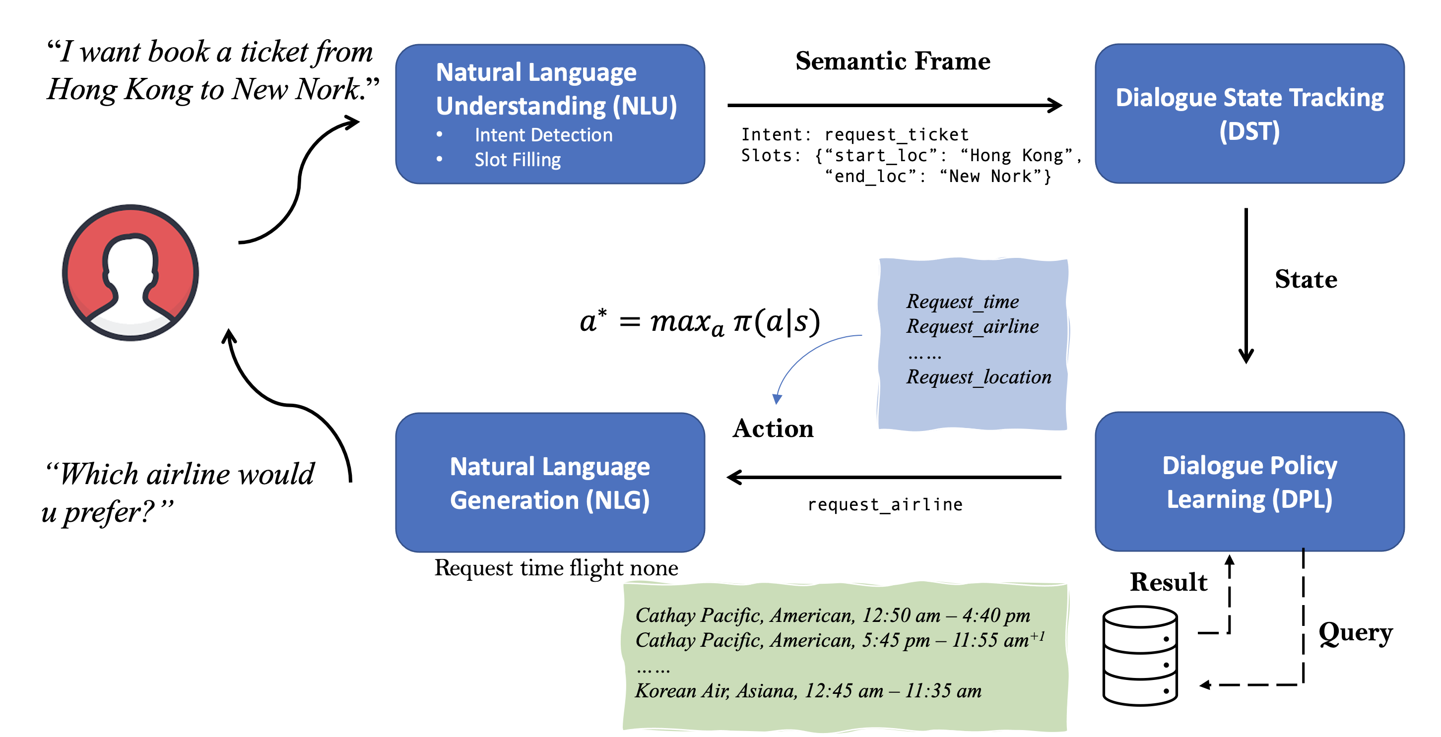
What’s Dialogue System ?
A Survey on Recent Advances and Challenges in Reinforcement Learning Methods for Task-oriented Dialogue Policy Learning. MIR

Slide 5
What’s Dialogue System ?
#18 from http://coai.cs.tsinghua.edu.cn/hml/media/files/dialog.pdf

Slide 6
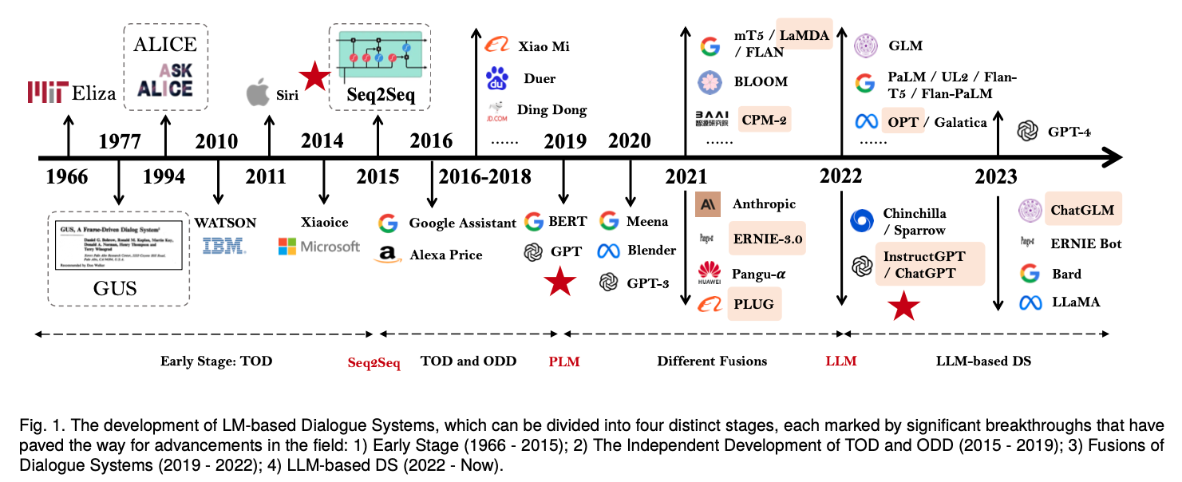
The History of Dialogue System
A Survey of the Evolution of Language Model-Based Dialogue Systems

Slide 7
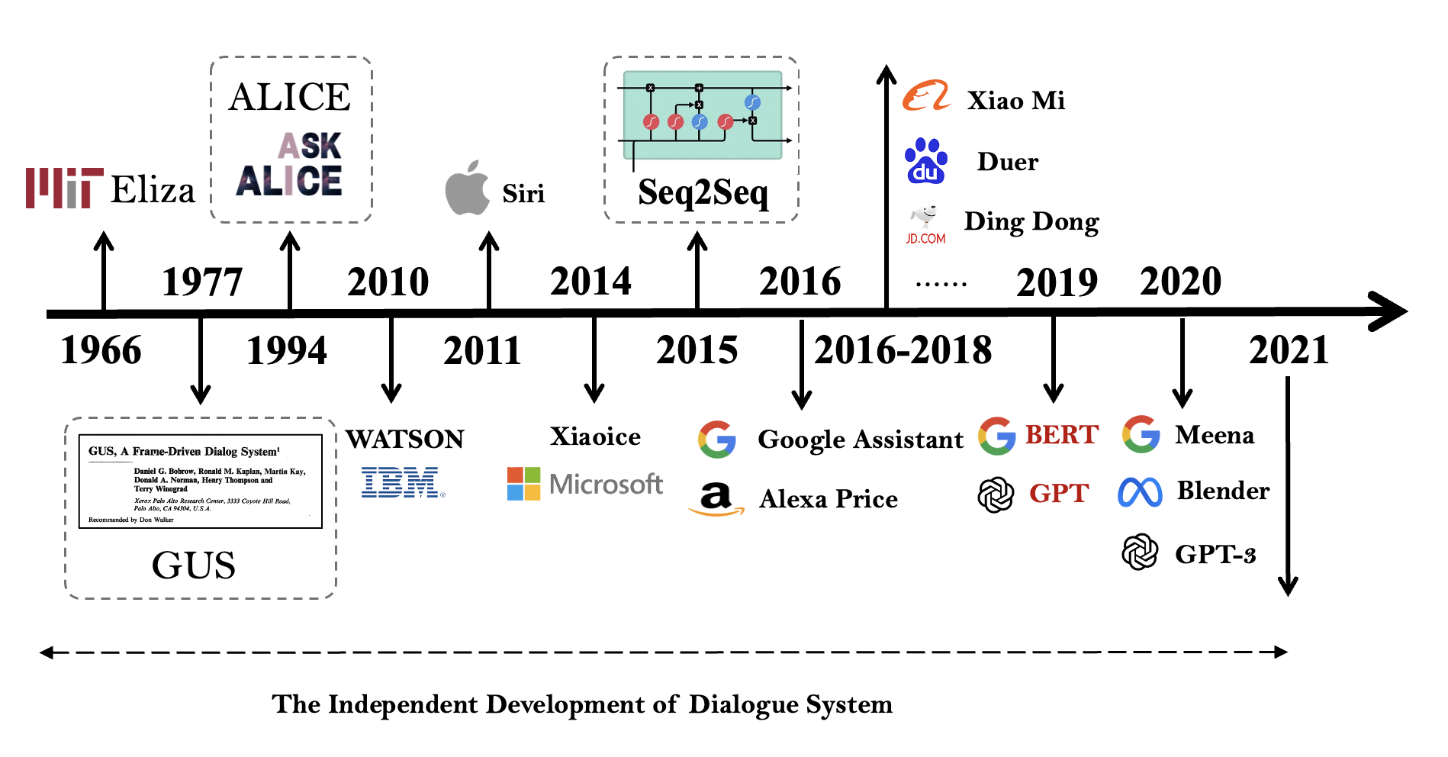
The Independent Development of Dialogue System
Early Works
Eliza / GUS / Alice / ……
First Milestone: Seq2Seq network
RNN: LSTM / GRU
Open-domain DS attracts attention
Second Milestone: Transformer
Encoder: Bert
Decoder: GPT
Others: UniLM, …..
rule-based / machine learning / simple task，task-oriented
Task
Single-domain
Multiple-domain
Cross-domain
Pre-trained Language Models
(PLM）
Architecture
Rule-based
RNN
Transformer
Notes:
they can be classified as task-oriented ds
thanks to appearance of seq2seq framework, open-domain ds attracts attention since it firstly got formal definition.
From now, both of tasks and architectures becomes more advanced and complicated,
task evolves from single-domain to multiple domain to cross-domain, and architecture xxxxx
leading to the appearance of pre-trained language models, such as bert and gpt

Slide 8
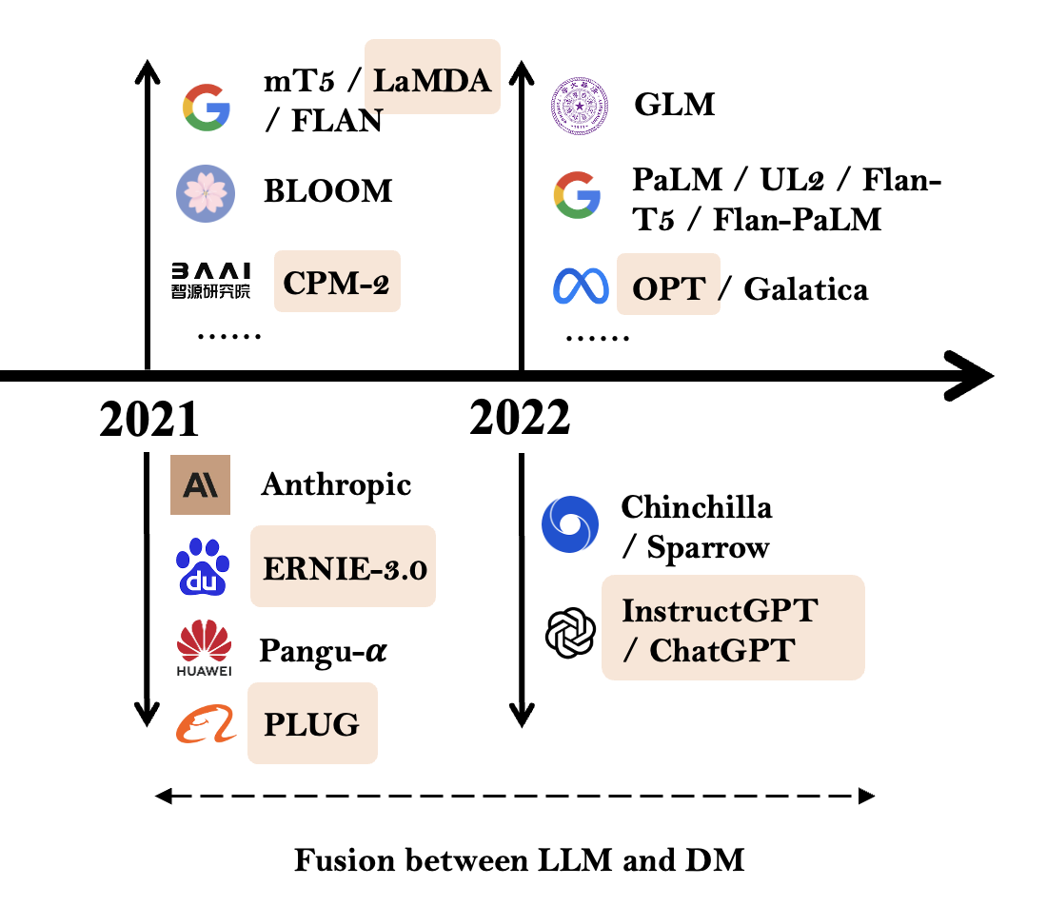
Fusion between LLM and Dialogue Model
Fusion 1: Task-oriented DS and Open-domain DS (PLM)
Fusion 2: Large Language Models and Dialogue Models
A Survey of the Evolution of Language Model-Based Dialogue Systems
Notes:
Then the second stage is fusion between llm and dialogue model
There are two trends

Slide 9
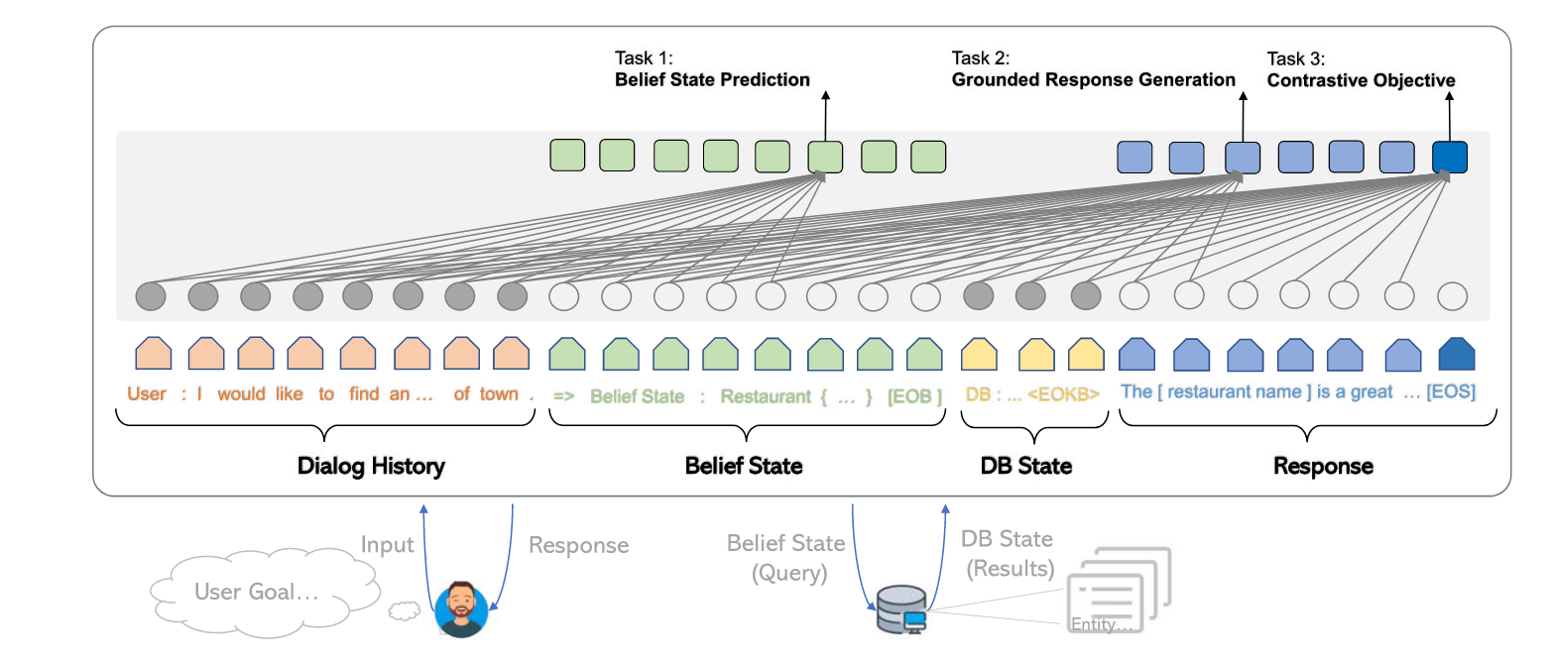
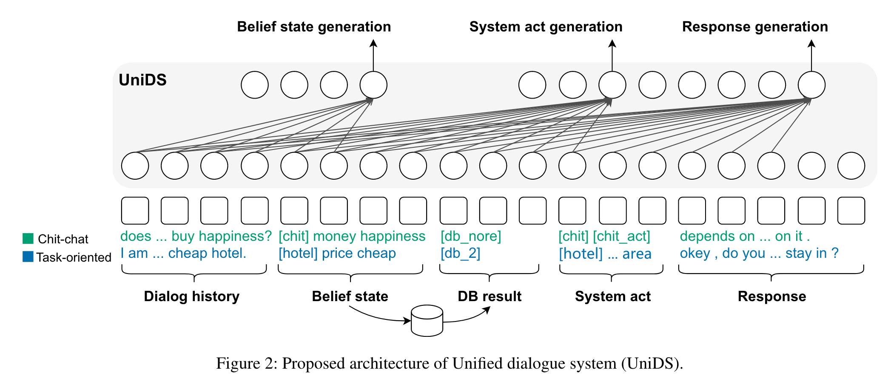
Fusion 1: Task-oriented DS and Open-domain DS
Fusion inside Task-oriented DS
NLU
DST
DPL
NLG
Fusion between Task-oriented DS and Open-domain DS
End2End (E2E) Task-oriented DS
SOLOIST: One example of End2End (E2E) Task-oriented DS
PPTOD: Multi-task Plug-and-Play Task-oriented DS
Task-oriented Dialogue System
Open Domain Dialogue System
Notes:
The fusion between task-oriented ds and open-domain ds starts from the fusion between four components in task-oriented ds SOLOIST as shown in fuses DST and NLG by formulating task-oriented ds in an end-to-end manner following this paradigm, lots of works fuses different components in task-oriented ds, and at the last, PPTOD fuses all sub-tasks together.
This framework of task-oriented ds called end2end task-oriented ds, to be distinguished from traditional pipeline system.
In this way, the framework is similar with open-domain ds, thus there are some works start to fuse e2e task-oriented ds and open-domain ds, by designing a unified data schema. 10 mins

Slide 10
Fusion 2: LLMs and DMs
Task
Single-domain
Multiple-domain
Cross-domain
Pre-trained Language Models
(PLM）
Architecture
Rule-based
RNN
Transformer
GPT-2
In-domain finetuning
PLM
Dialogue Model
Scaling
(data and size)
LLM as DM
In-domain finetuning
LLM
LLM-based Dialogue Model
ChatGPT
GPT-3.5
Notes:
Secondly, as we introduced before, the pre-trained lm becomes important in ds, with the suitable scaling at the data and model size, the PLM becomes LLM. Due to tremendous and diverse pre-training corpus, almost all LLMs can be directly used as dialogue model. After further in-domain finetuning, LLM-based Dialogue Model appears. The examples is GPT-2 (PLM) GPT-3.5 (LLM) and ChatGPT

Slide 11
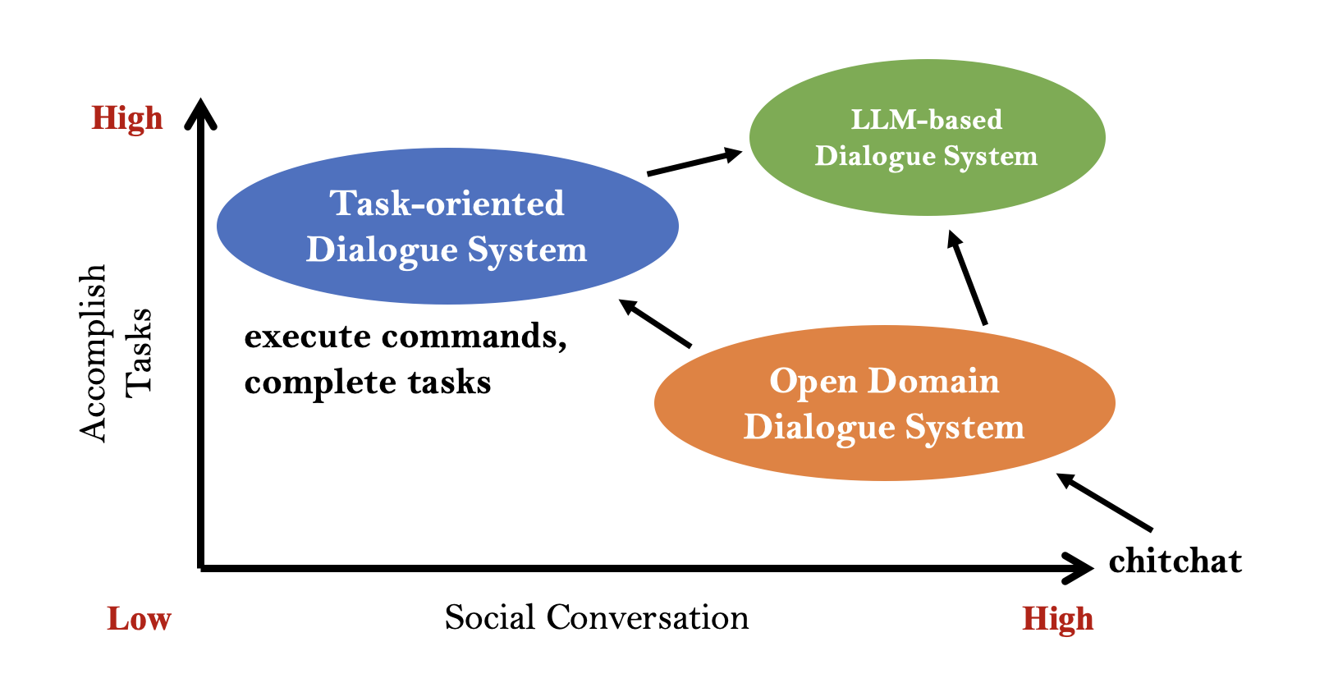
What’s LLM-based Dialogue System ?
A Survey of the Evolution of Language Model-Based Dialogue Systems

Slide 12
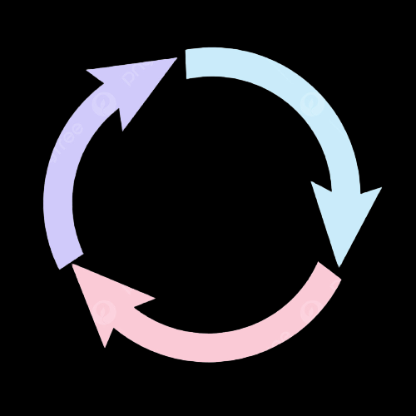
What’s LLM-based Dialogue System ?
LLM-based
Dialogue System
Large Language Models as Source Planner for Personalized Knowledge-grounded Dialogue (External)
Cue-CoT: Chain-of-thought Prompting for Responding to In-depth Dialogue Questions with LLMs (Internal)
Evidences
Resp
Database
Emotion
Persona
Psychology
Internal Status
External
Sources
……
Document
……
Intermediate Reasoning
Memory
Dialogue
Context
TPE: Towards Better Compositional Reasoning over Conceptual Tools with Multi-persona Collaboration (Internal with External)

Slide 13
Cue-CoT (Internal Capability )
LLM-based
Dialogue System
Large Language Models as Source Planner for Personalized Knowledge-grounded Dialogue (External)
Cue-CoT: Chain-of-thought Prompting for Responding to In-depth Dialogue Questions with LLMs (Internal)
Evidences
Resp
Database
Emotion
Persona
Psychology
Internal Status
External
Sources
……
Document
……
Intermediate Reasoning
Memory
Dialogue
Context
TPE: Towards Better Compositional Reasoning over Conceptual Tools with Multi-persona Collaboration (Internal with External)

Slide 14
What is the internal capability ?
Large Language Models (LLMs) possesses exceptional natural language understanding and generation capabilities, making it an ideal foundation for a conversational system that provides a great user experience and significant convenience.
But:
Most of them directly mapping the dialogue context to the response
Ignoring the linguistic cues underneath dialogue context such as user status, and thus lacks the ability to employ corresponding language styles and knowledge systems when dealing with users of different personalities, emotions, and psychological states.
Notes:
Most of LLM-based DS directly mapping the dialogue context to the response
As shown in the figure, according to the content of dialogue, we can infer the persona of uses is curious, and focus on finance domain, …
To provide a tailored response, we must consider the user status exhibited during the conversation

Slide 15
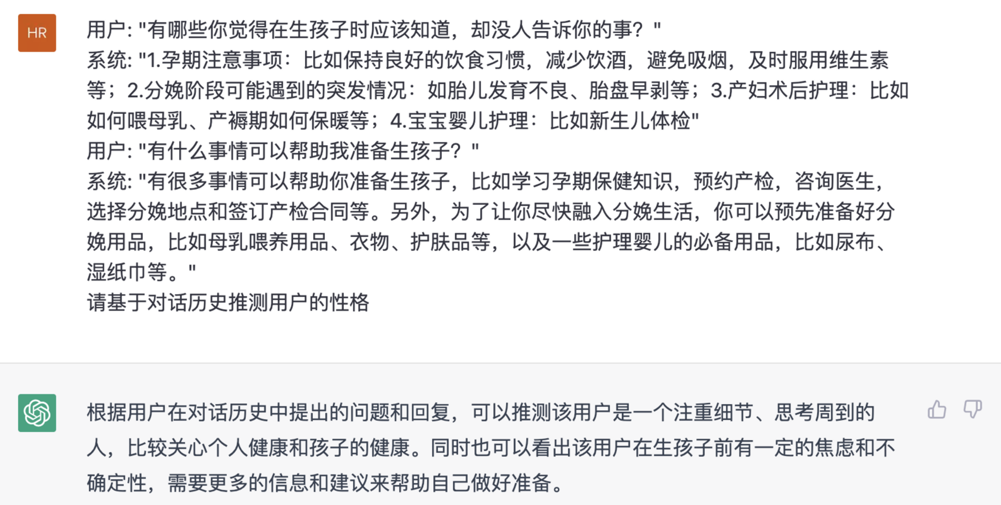
Multi-step Reasoning
We formulate it as a multi-step reasoning problem, can be alleviated by CoT, which is not explored at dialogue.
First, infer and trace the core of the user's question or concern.
Then, plan a response that takes into account their status like emotional state and psychological well-being. （optional)
…… (optional)
Finally, generate a personalized dialogue response.

Slide 16
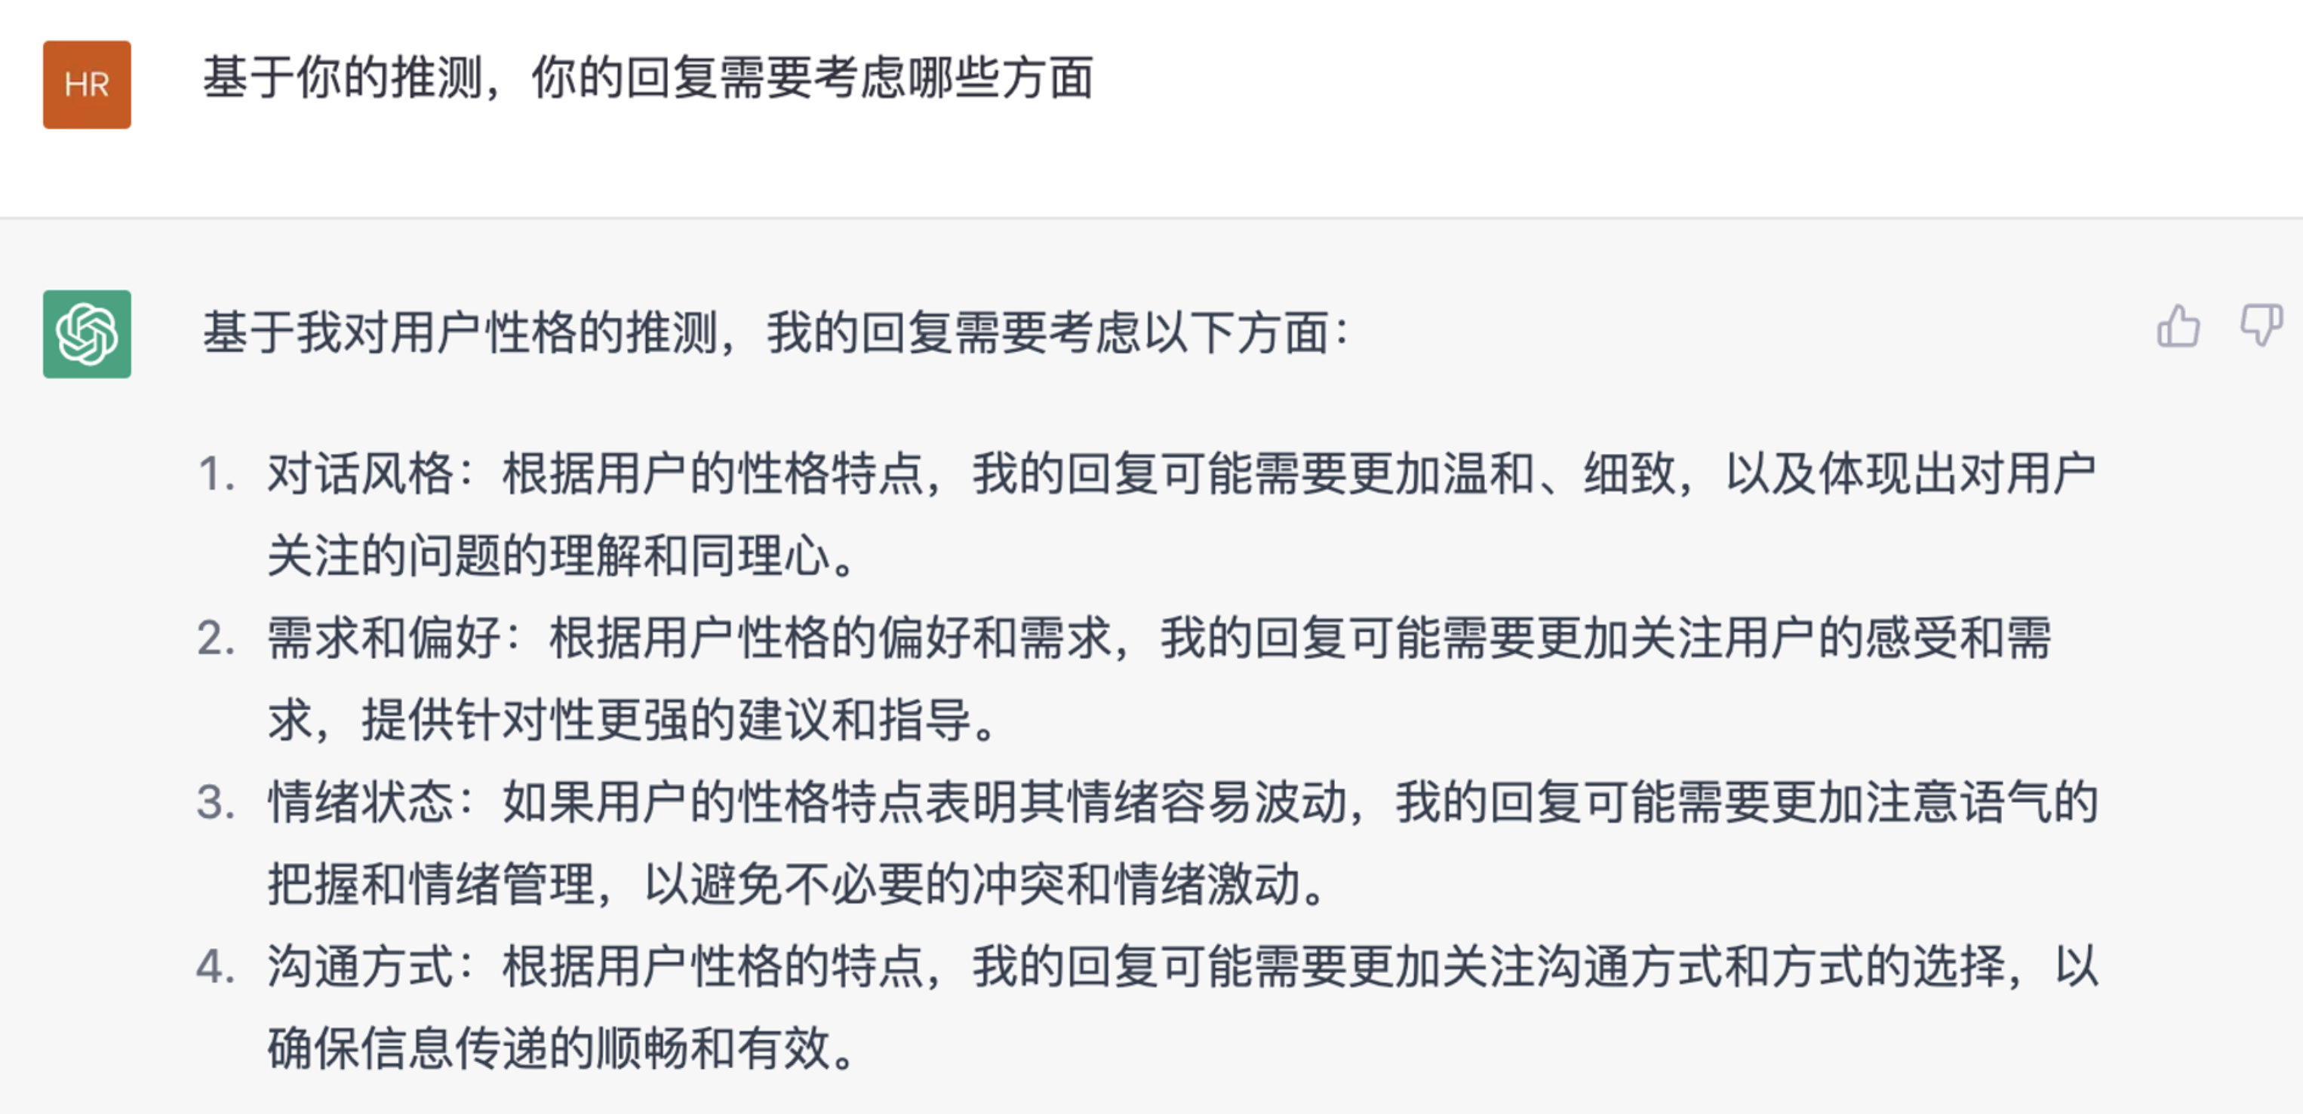
Multi-step Reasoning
We formulate it as a multi-step reasoning problem, can be alleviated by CoT, which is not explored at dialogue.
First, infer and trace the core of the user's question or concern.
Then, plan a response that takes into account their status like emotional state and psychological well-being (optional)
…… (optional)
Finally, generate a personalized dialogue response.
Notes:
Gentle, specific, and provide emotional support, and also other aspects need to attention

Slide 17
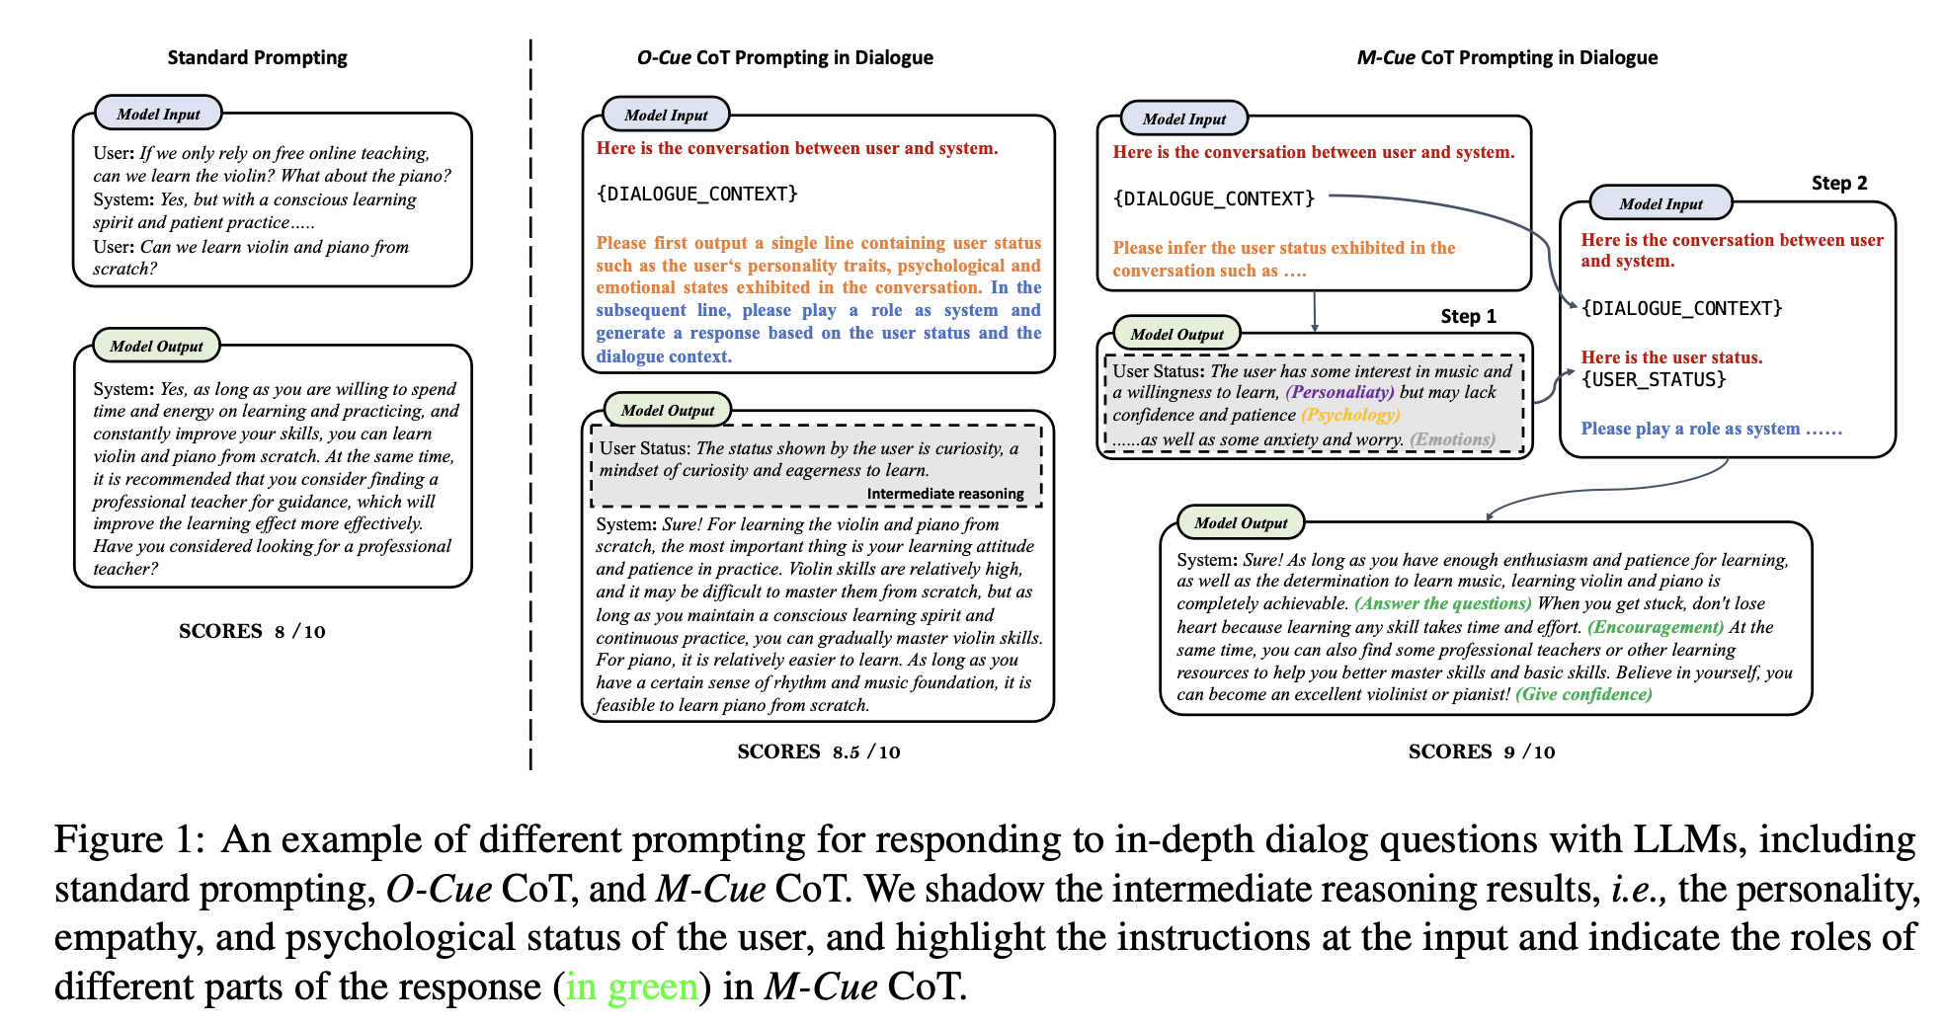
Cue-CoT
Notes:
There are many advantages of M-CoT, it is more interactive and controllable.

Slide 18
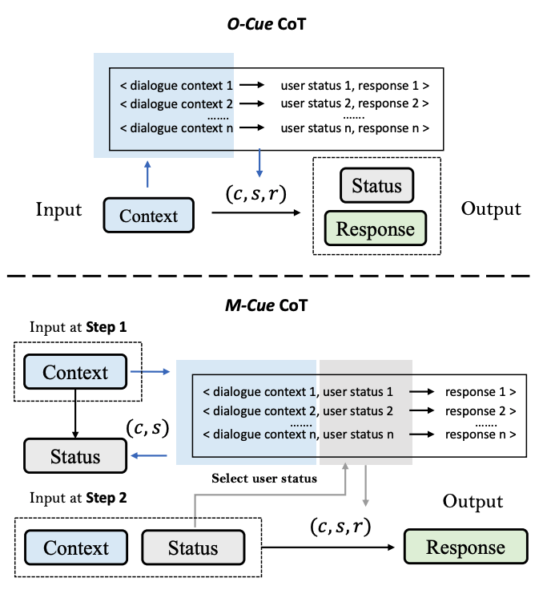
Cue-CoT (Few-shot)
Since there are multiple steps, we design different selection strategies for each step. Specifically, we first select demonstrations (c, s) according to dialogue context to infer status, and then select demonstrations (c, s, r) according to user status.
On the one hand, all intermediate reasoning results can be utilized as a criterion to select demonstrations, providing additional signals for the latter reasoning.
On the other hand, It is convenient to process these intermediate outputs, allowing for actions such as incorporating user profiles for personalization or filtering out erroneous reasoning results. These intermediate outputs can also be stored for future use, enabling their utilization for various purposes.
Notes:
There are many advantages of M-CoT, it is more interactive and controllable.

Slide 19
Benchmark
Three major linguistic cues are considered:
Personality: Zhihu & Quora (Self-built)
Emotion: D4 & ED
Psychology: PsyQA & EMH
Settings
Zero-shot
One-shot
demonstration selection
M-Cue according to internal status in 2nd step
Random
Top-1

Slide 20
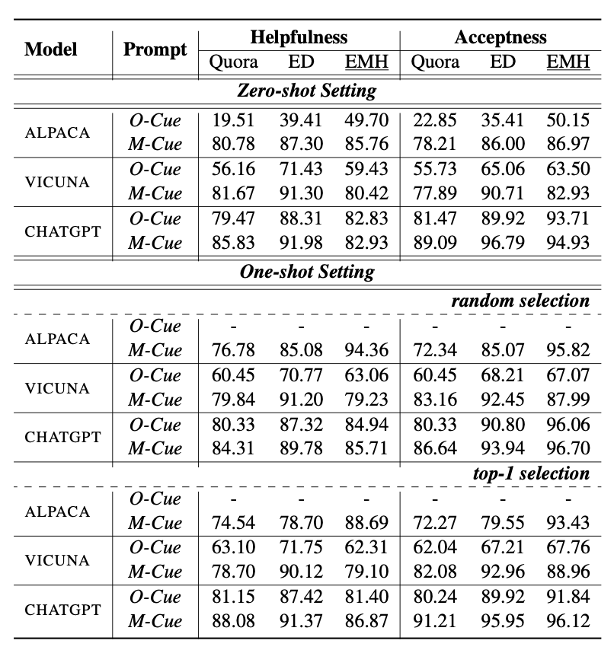
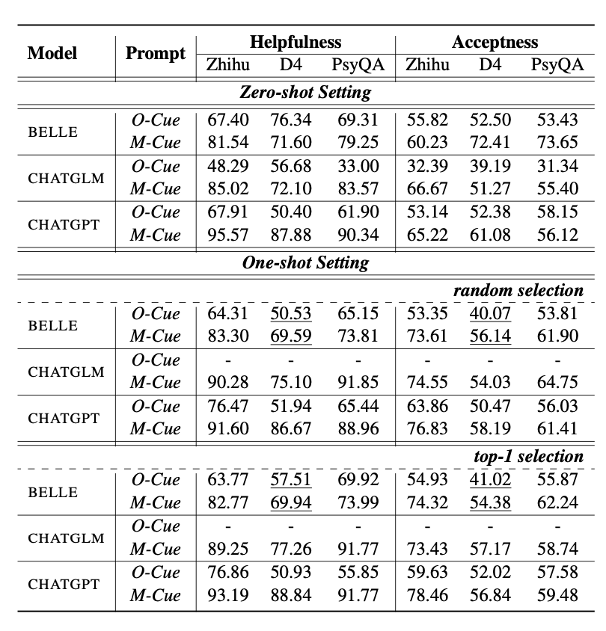
Experiment
O-Cue and M-Cue both are better than Standard Prompting, and M-Cue is more general and robust
Chinese LLMs
BELLE： low long-context understanding ability; middle instruction-following ability
ChatGLM: middle long-context understanding ability; low instruction-following ability
ChatGPT: both high
English LLMs
…….
Notes:
more fair and conviencing comparision
For Chinese llm, we can observe that chatgpt achieves better

Slide 21
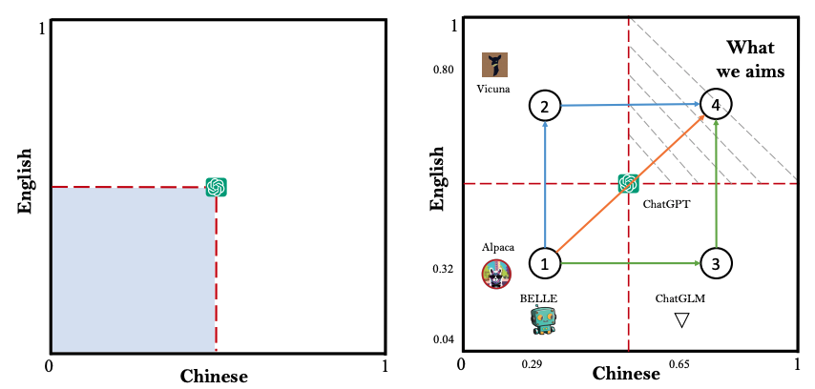
Discussion & Future Work
Path 1 (orange): Directly extend the capability of ChatGPT. GPT-4, Claude, Bard, ……
Path 2 (green): Continually train current Chinese LLMs on more multi-lingual corpus.
Path 3 (blue): Continually train current English LLMs on more multi-lingual corpus. Chinese-LLaMA, Chinese-Vicuna, …..
More analysis, case studies can be found in the paper! Demo can be accessed in the Github!!!
Notes:
more fair and conviencing comparision
For Chinese llm, we can observe that chatgpt achieves better

Slide 22
SAFARI (External Capability )
LLM-based
Dialogue System
Large Language Models as Source Planner for Personalized Knowledge-grounded Dialogue (External)
Cue-CoT: Chain-of-thought Prompting for Responding to In-depth Dialogue Questions with LLMs (Internal)
Evidences
Resp
Database
Emotion
Persona
Psychology
Internal Status
External
Sources
……
Document
……
Intermediate Reasoning
Memory
Dialogue
Context
TPE: Towards Better Compositional Reasoning over Conceptual Tools with Multi-persona Collaboration (Internal with External)

Slide 23
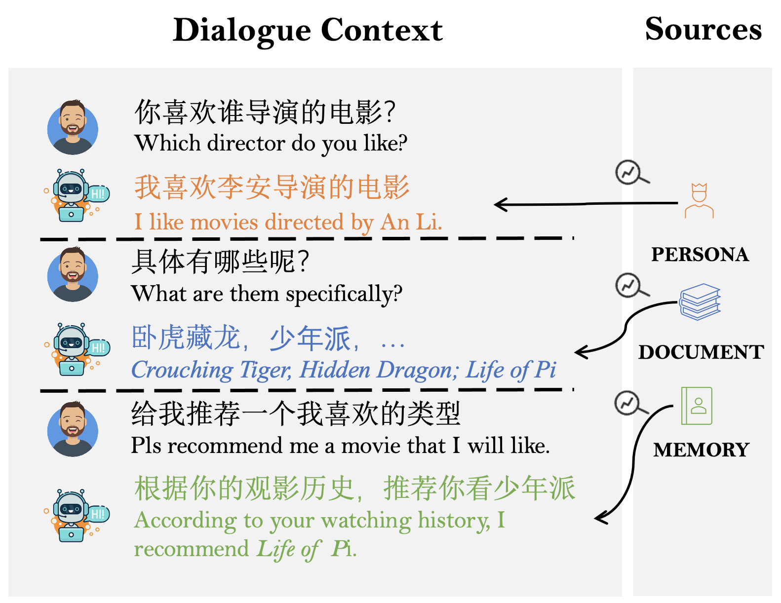
What is the external capability ?
Open-domain Dialogue System requires access to various external knowledge sources to deliver reliable, informative, personalized, and helpful responses, depending on which sources are invoked.
Indiscriminately incorporating all sources bring unnecessary computing cost, and sometimes it does not require external knowledge.
The interdependence between different external sources brings new challenges, while ignoring the complex relationship between different sources, leads to sub-optimal performance.

Slide 24
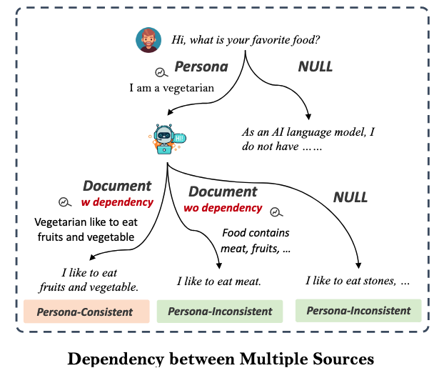
A case of dependency between different knowledge sources
How to infuse these different knowledge {Document, Persona, Memory} with dependency into one framework ?

Slide 25
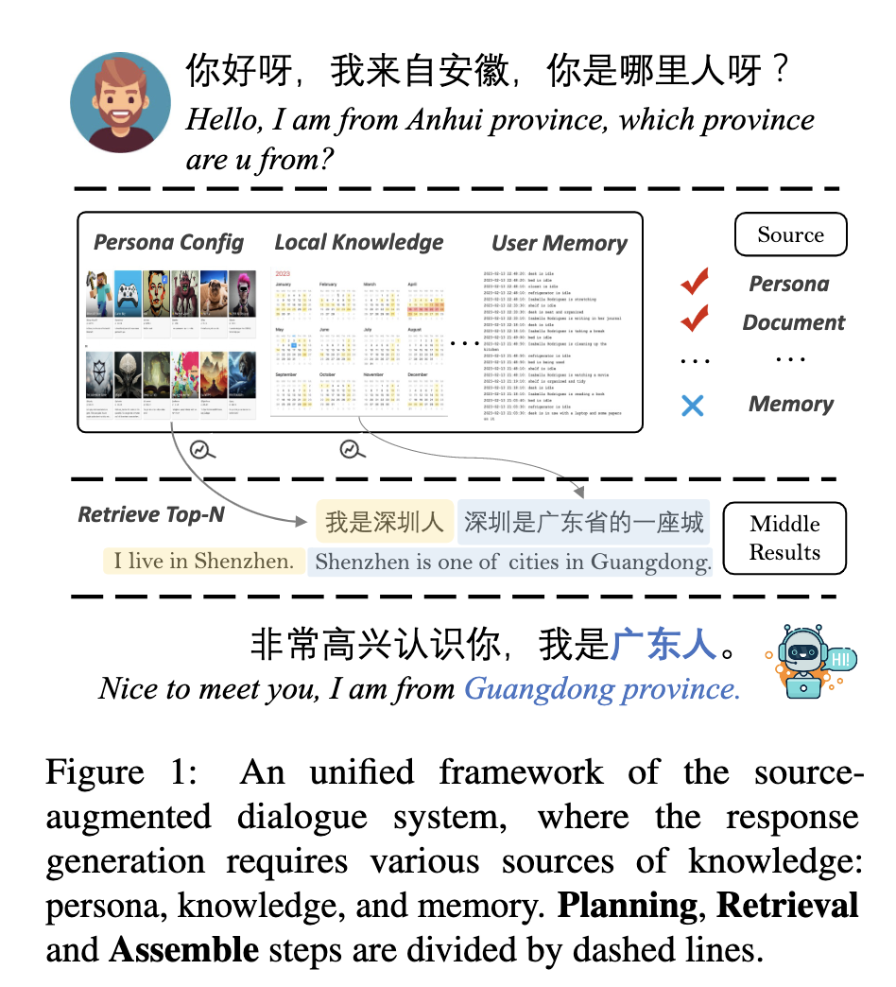
SAFARI Framework
Planning: make a series of decision to determine whether or not use knowledge, which and when.
Retrieval: retrieve top-n results from local databases according to the decided used source knowledge
Assembling: incorporate all retrieved middle results into the final response generation

Slide 26
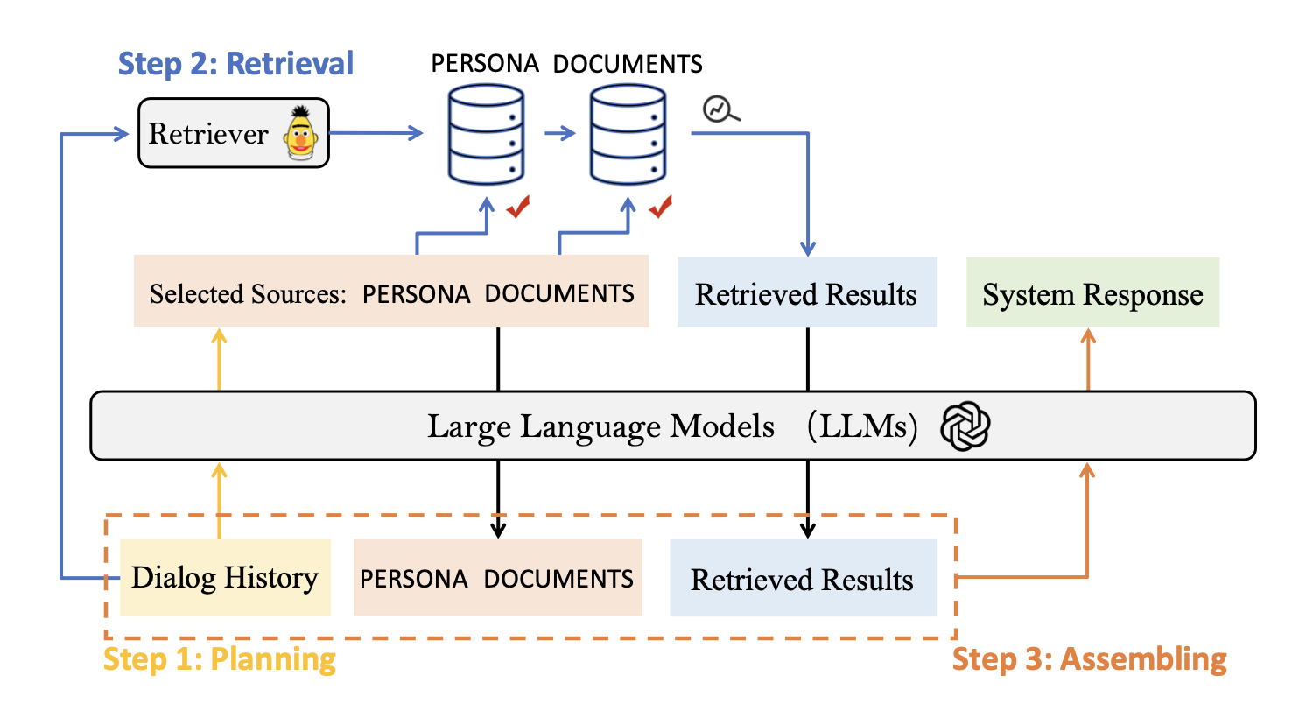
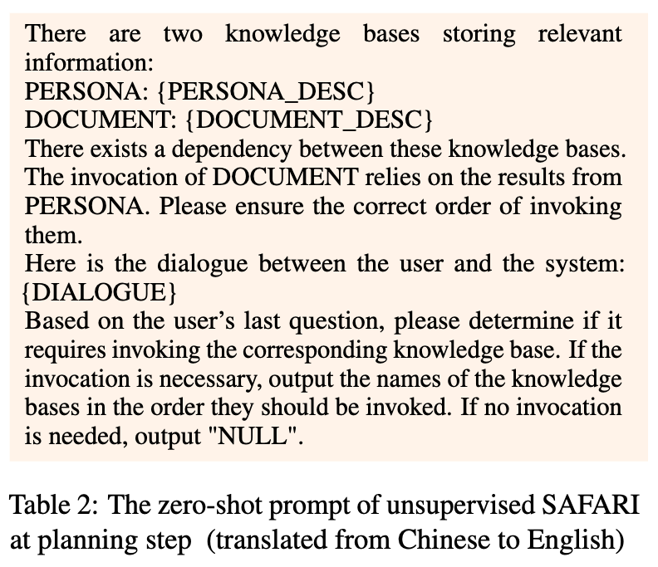
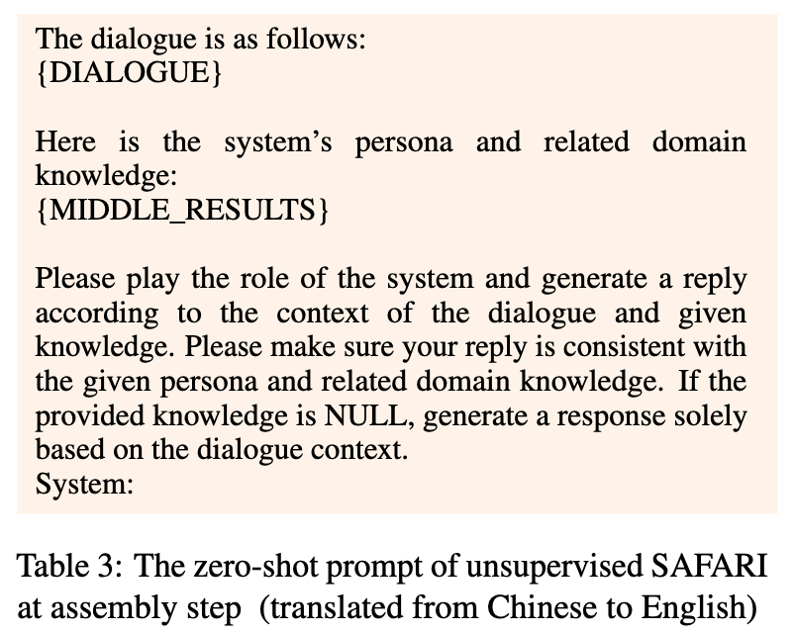
SAFARI Framework
Supervised SAFARI (End-to-end Training, LoRA)
Unsupervised SAFARI
Supervised SAFARI
Unsupervised SAFARI

Slide 27
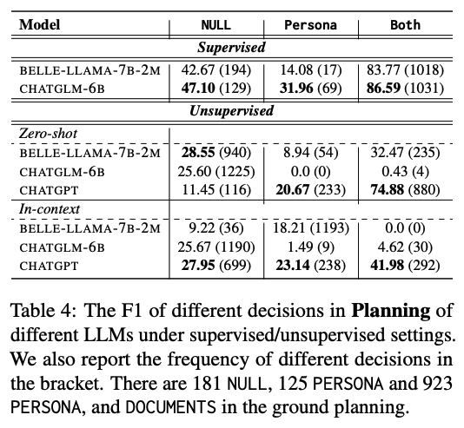
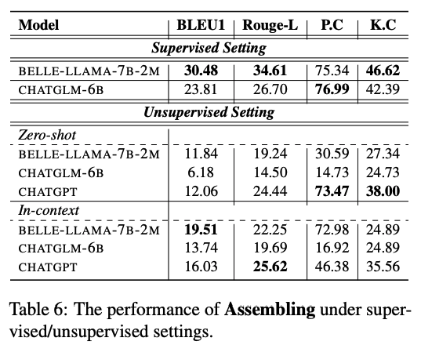
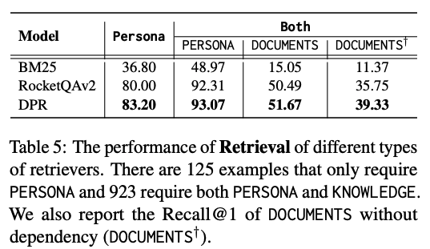
SAFARI Framework
Performance of Planning
Supervised ChatGLM > Supervised BELLE > Unsupervised ChatGPT > Others
Performance of Retrieval
DPR > RocketQAv2 > BM25
Performance of Assembling
Supervised BELLE > Supervised ChatGLM

Slide 28
TPE (Internal with External Capability)
LLM-based
Dialogue System
Large Language Models as Source Planner for Personalized Knowledge-grounded Dialogue (External)
Cue-CoT: Chain-of-thought Prompting for Responding to In-depth Dialogue Questions with LLMs (Internal)
Evidences
Resp
Database
Emotion
Persona
Psychology
Internal Status
External
Sources
……
Document
……
Intermediate Reasoning
Memory
Dialogue
Context
TPE: Towards Better Compositional Reasoning over Conceptual Tools with Multi-persona Collaboration (Internal with External)

Slide 29
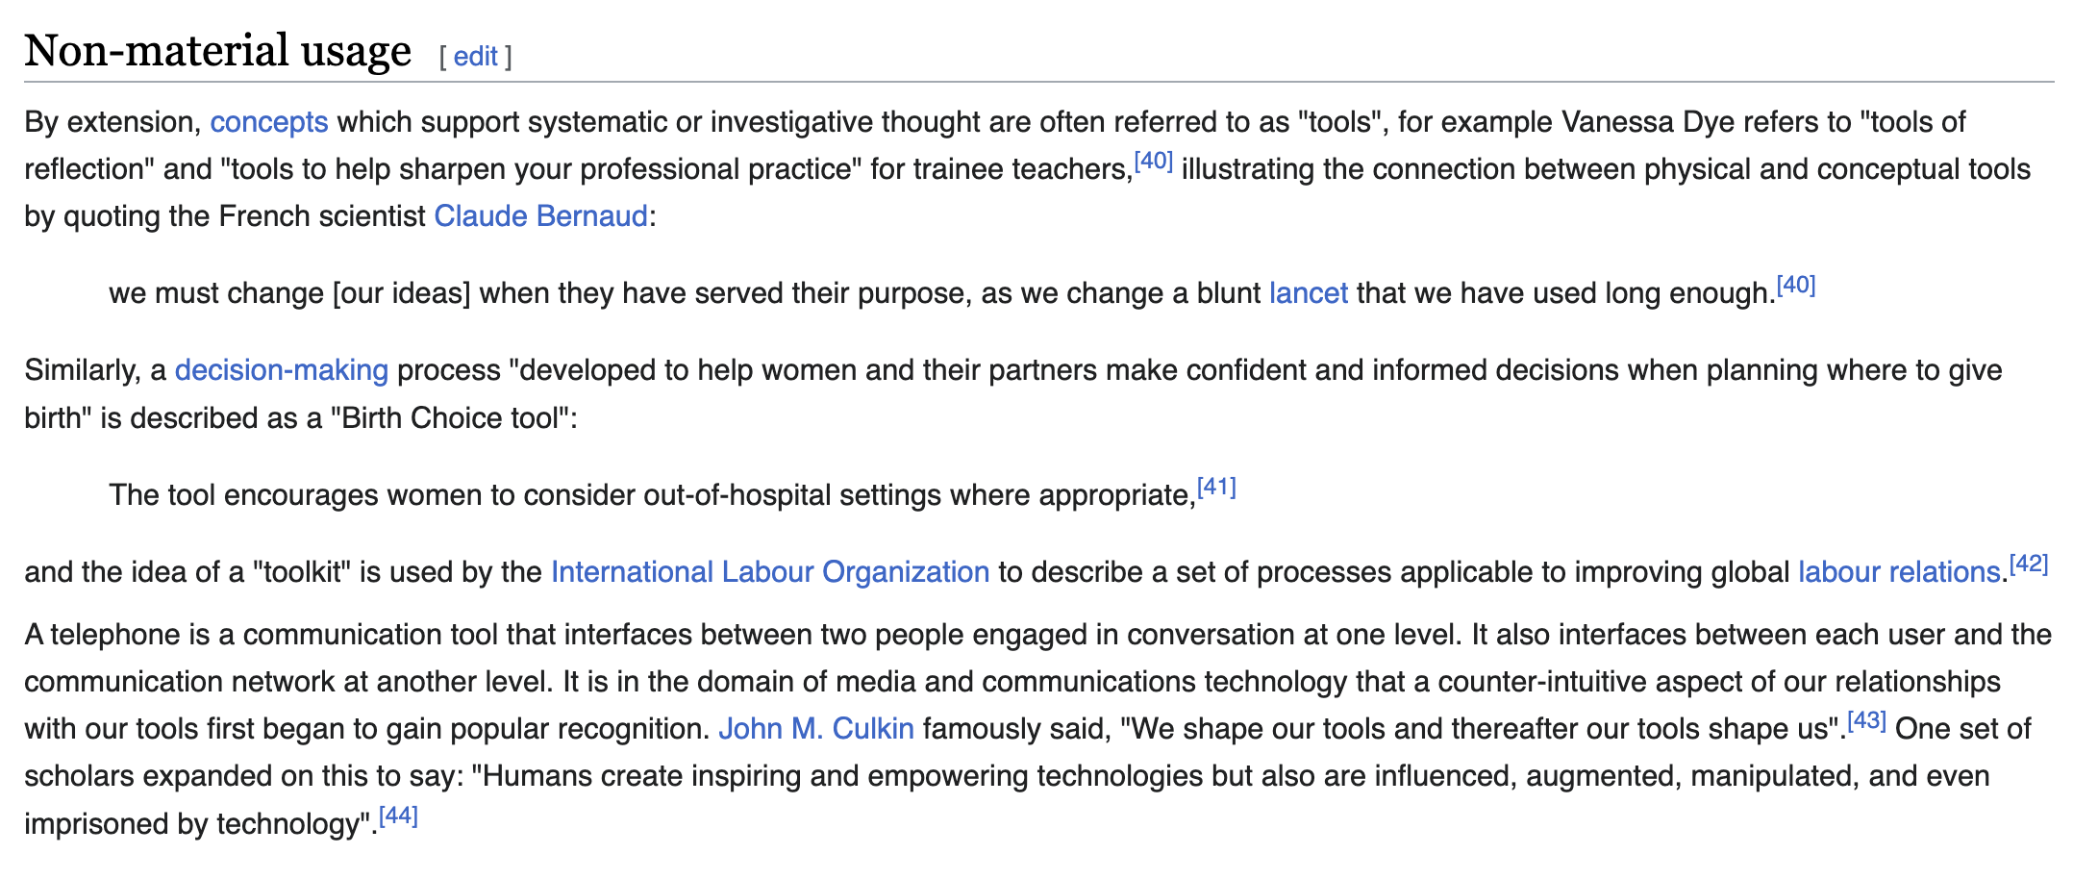
What’s tool?
Tool: An object carried or maintained for future use.
— Finn, Tregenza, and Norman, 2009.
Tool can be either:
Functional tool, or
Retriever / calculator ….
Conceptual tool
Decision-making process
Different conversational strategies
Different sources
…..
A conceptual tool specifies a cognitive concept used to help systematic or investigative thought

Slide 30
What’s tool?
Using different tools to interact with complex external environments
What is the tool ?
Functional Tool
Models
Image-to-caption
Object-detection
….
Retriever
Calculator
Programs
……
Conceptual Tool
Conversational Strategies
Question
Trust
…..
Different Sources of Knowledge
Memory
Document
….
……

Slide 31
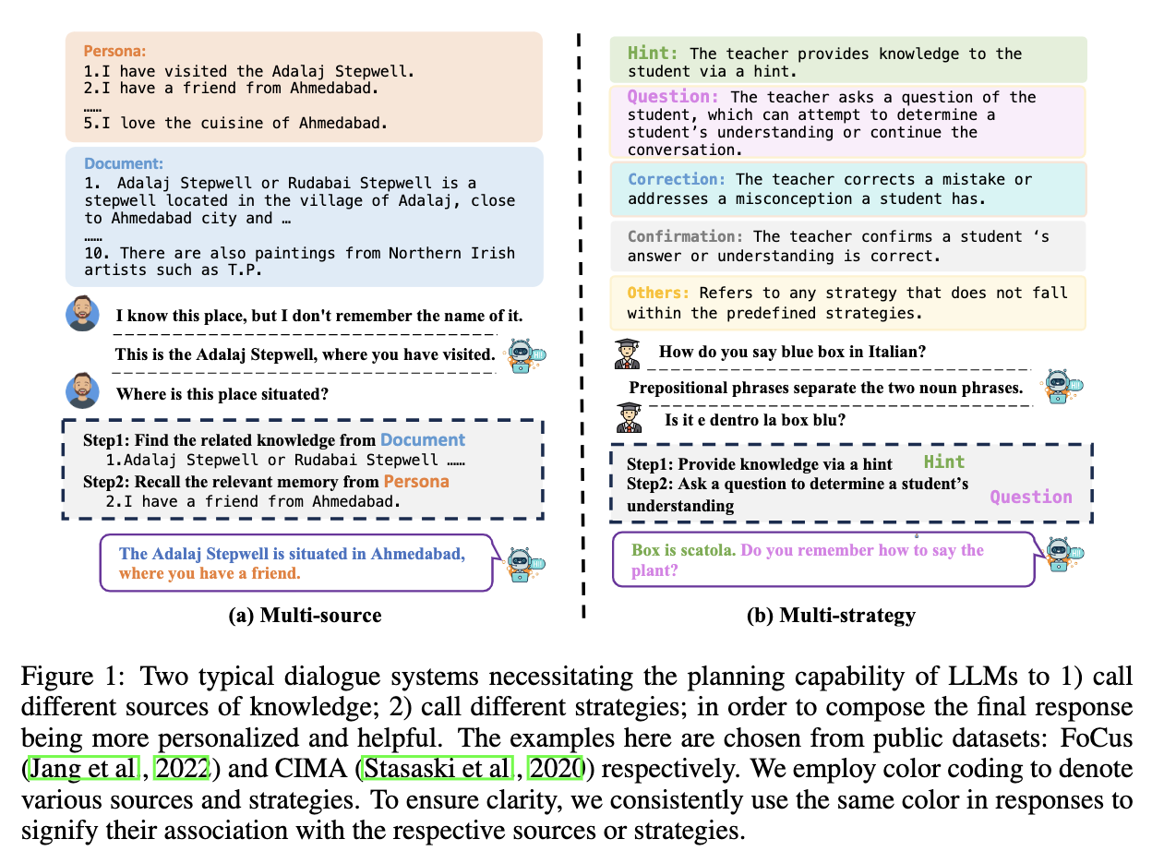
Tools in LLM-based DS
Two typical conceptual tools in DS:
Source
Memory
Documents
Persona
…
Strategy
Trust
Decompose
…

Slide 32
TPE -- Multi-persona Collaboration Framework

Slide 33
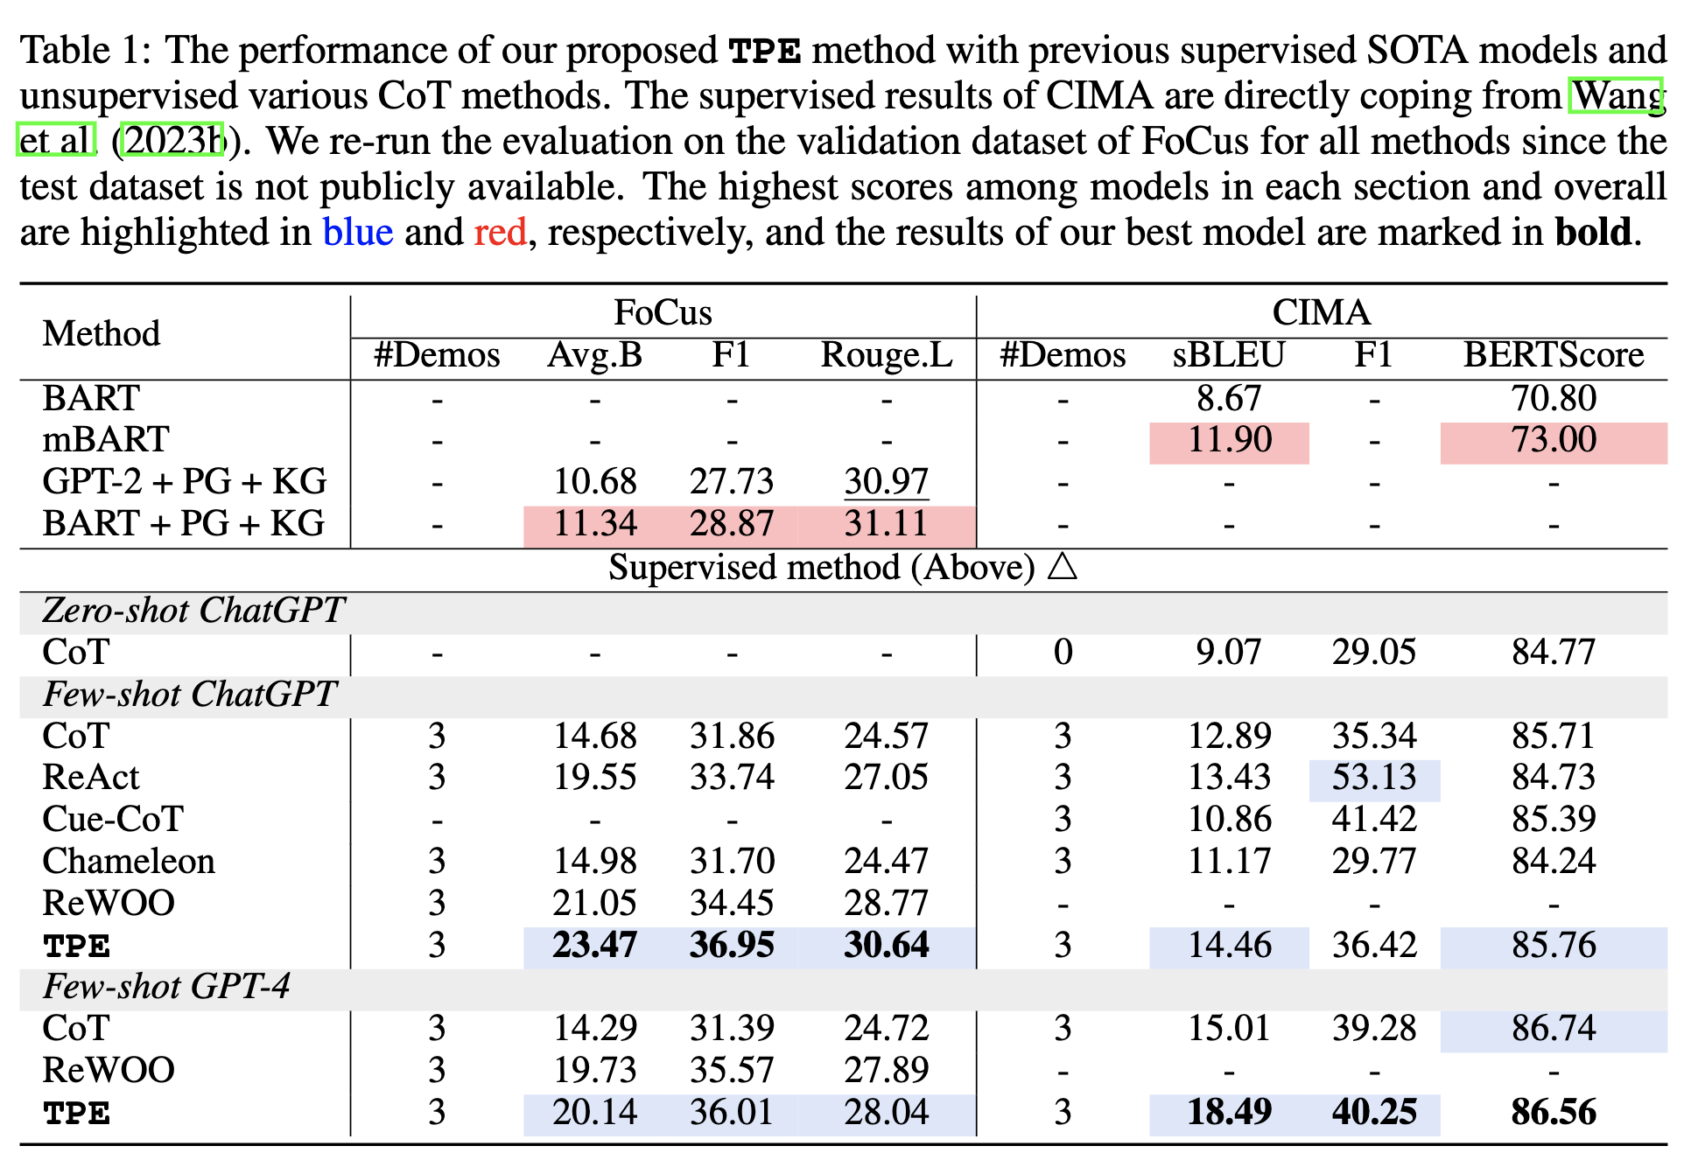
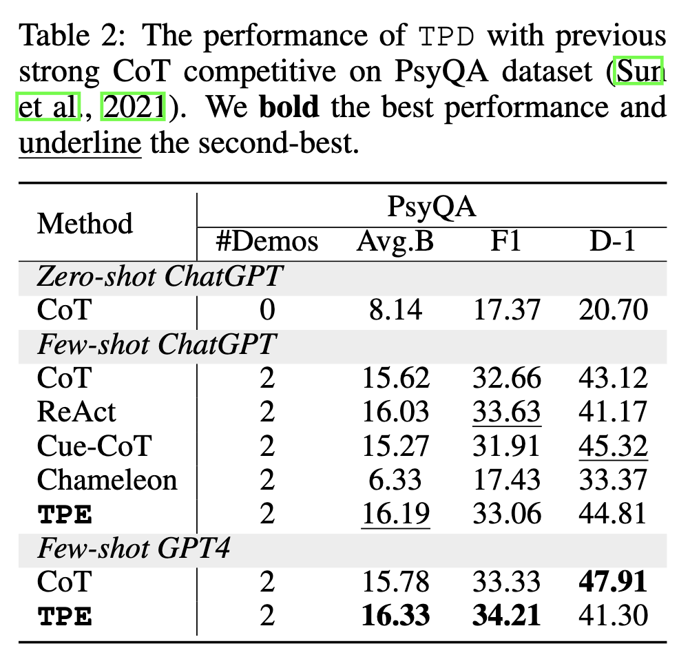
Experiment

Slide 34
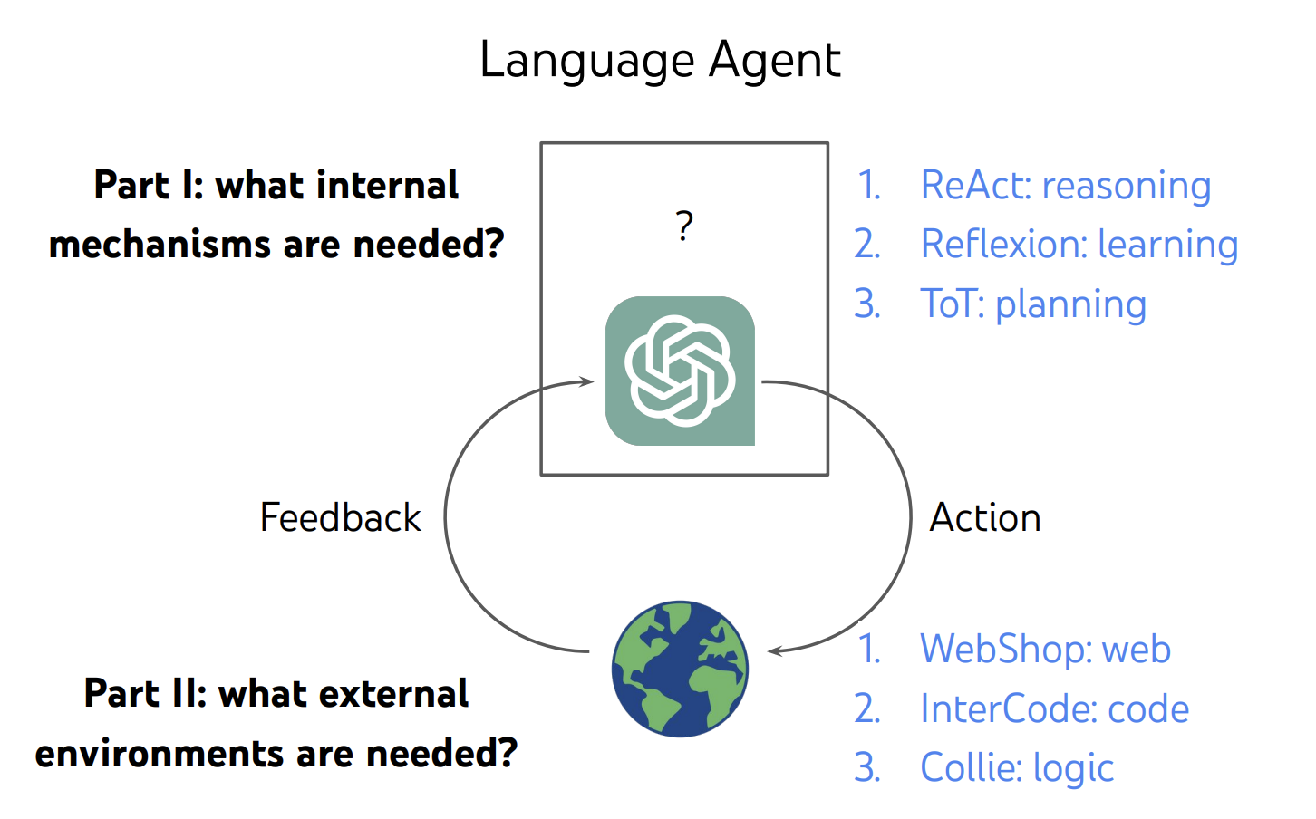
What’s Language Agent ?
LLM-based Dialogue Systems as Language Agents
https://ysymyth.github.io/papers/from_language_models_to_language_agents.pdf

Slide 35
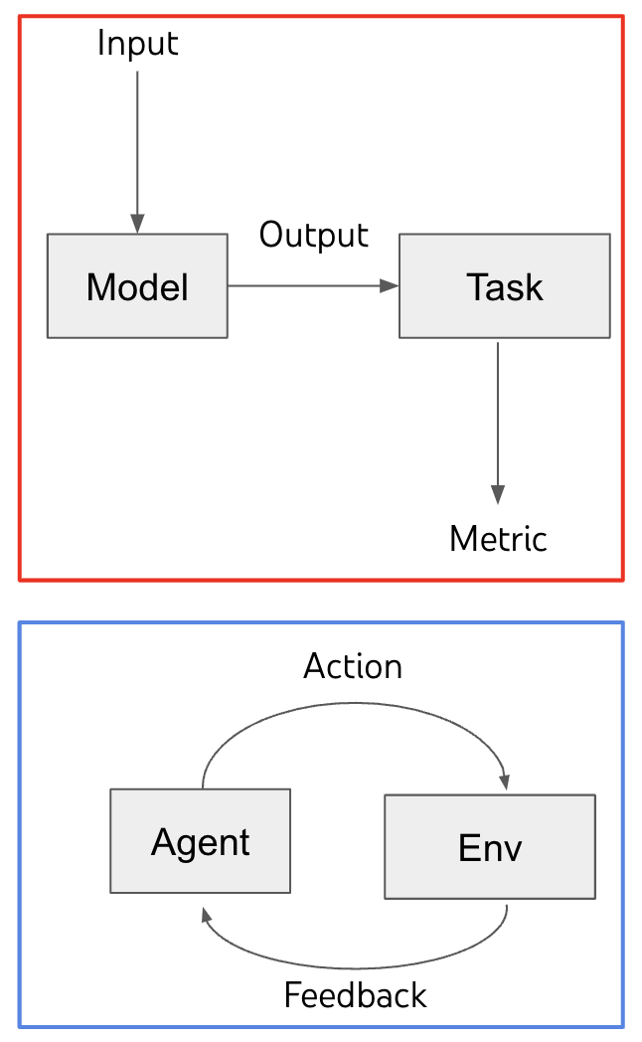
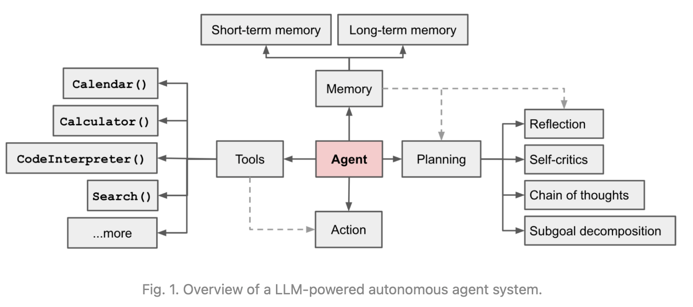
Language Models → Language Agents
Agent = reasoning + acting + memory + decision making…
https://lilianweng.github.io/posts/2023-06-23-agent/
https://docs.google.com/presentation/d/1FkANjhY9zyFXFQSpceKm5R9pklxmqvCa4oezgE64wWY/edit#slide=id.g257e713d96c_0_458

Slide 36
Language Agents → Language Agents (LLM-based DS)
Language model was invented to generate text autoregressively
Not invented as general problem solvers, or AGI
Agent = reasoning + acting + memory + decision making…
Natural language processing -> natural language interaction
Generate tokens -> generate internal/external actions
Decoding -> decision making
….
Lot of opportunities for new methods, benchmarks, and applications
https://docs.google.com/presentation/d/1FkANjhY9zyFXFQSpceKm5R9pklxmqvCa4oezgE64wWY/edit#slide=id.g257e713d96c_0_458

Slide 37
Conclusion
Agent = reasoning + acting + memory + decision making…
Reasoning -> Prompting (CoT, ToT, CueCoT)
Acting -> Generate Tokens (Reflection tokens, SAFARI)
Memory -> One of conceptual tools
Decision making -> Contextual tools & Functional tools (TPE)
……

Slide 38
References
A Survey of the Evolution of Language Model-Based Dialogue Systems
TPE: Towards Better Compositional Reasoning over Conceptual Tools with Multi-persona Collaboration
Cue-CoT: Chain-of-thought Prompting for Responding to In-depth Dialogue Questions with LLMs, EMNLP 2023
Large Language Models as Source Planner for Personalized Knowledge-grounded Dialogues , EMNLP 2023

Slide 39
Thanks.
Hongru WANG
https://rulegreen.github.io/
https://github.com/ruleGreen/Survey-Evolution-DS
Code & Benchmark
Homepage
Zhihu

